Slide 1



Automated Reasoning about Software ($67532$)
Guy Katz
Lecture $12$: Revised Simplex January $13$^{th}, $2020$

Slide 2
Acknowledgements
Some of the material presented has been borrowed from slides by David Dill, Isil Dillig, Gera Weiss, Clark Barrett, Alex Aiken, Mooly Sagiv, Sagar Chaki and Ofer Strichman

Slide 3
Overview
Last time: the Simplex method
A highly effective way to solve linear programs
Main stages:
Find feasible solution
Optimize for the objective function using pivots
Strategy: pick entering/leaving variable pairs
Termination and performance
Today: how is Simplex implemented in practice

Slide 4
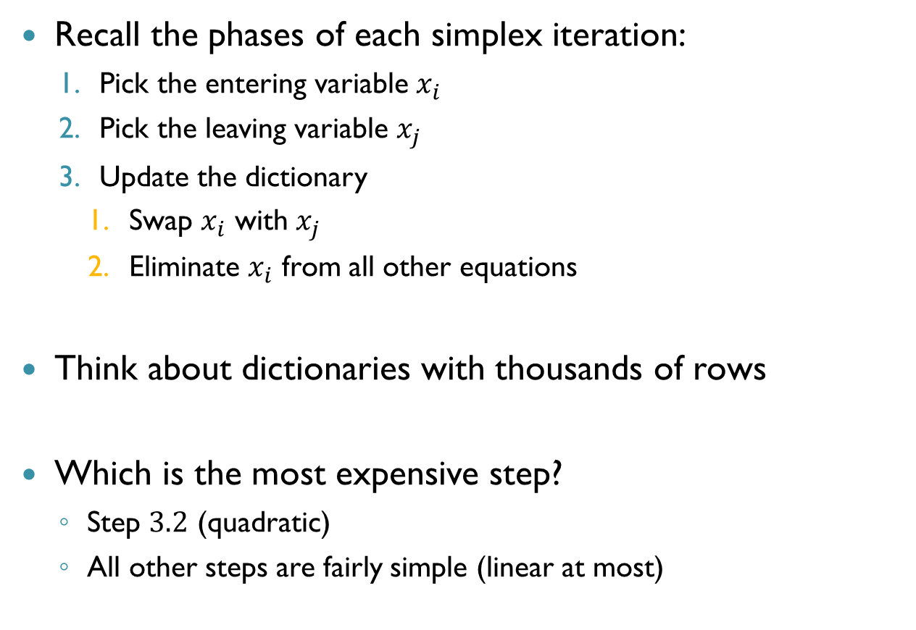
Motivation
Recall the phases of each simplex iteration:
Pick the entering variable $x_{i}$
Pick the leaving variable $x_{j}$
Update the dictionary
Swap $x_{i}$ with $x_{j}$
Eliminate $x_{i}$ from all other equations
Think about dictionaries with thousands of rows
Which is the most expensive step?
Step $3.2$ (quadratic)
All other steps are fairly simple (linear at most)

Slide 5
Motivation (cnt’d)
Goal: get rid of the quadratic-complexity step
Key idea: we will not store the dictionary explicitly
It will be more difficult to access information
But updating it will become trivial
This is called the revised Simplex method

Slide 6
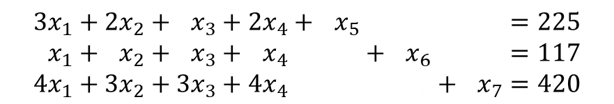
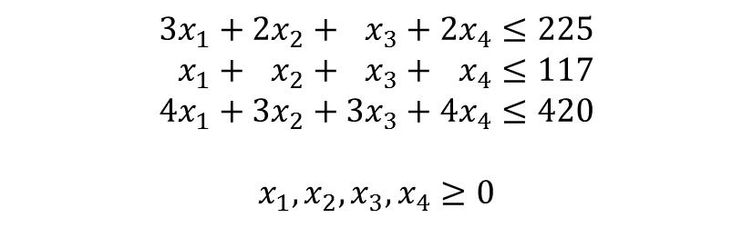

Recap: Tableau Form
Observe the following LP:
Tableau representation of equations:
maximize
$$19x_{1}+13x_{2}+12x_{3}+17x_{4}$$
$$3x_{1}+2x_{2}+1x_{3}+2x_{4}≤225$$
$$1x_{1}+1x_{2}+1x_{3}+1x_{4}≤117$$
$$4x_{1}+3x_{2}+3x_{3}+4x_{4}≤420$$
$$x_{1},x_{2},x_{3},x_{4}≥0$$
subject to
$$3x_{1}+2x_{2}+1x_{3}+2x_{4}+1x_{5}+1x_{6}+1x_{7}=225$$
$$1x_{1}+1x_{2}+1x_{3}+1x_{4}+1x_{5}+1x_{6}+1x_{7}=117$$
$$4x_{1}+3x_{2}+3x_{3}+4x_{4}+1x_{5}+1x_{6}+1x_{7}=420$$

Slide 7

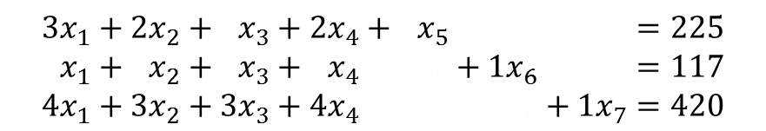




Matrix Representation
In matrix form:
$$3x_{1}+2x_{2}+1x_{3}+2x_{4}+1x_{5}+1x_{6}+1x_{7}=225$$
$$1x_{1}+1x_{2}+1x_{3}+1x_{4}+1x_{5}+1x_{6}+1x_{7}=117$$
$$4x_{1}+3x_{2}+3x_{3}+4x_{4}+1x_{5}+1x_{6}+1x_{7}=420$$
$$\left[\begin{matrix}3 & 2 & 1 & 2 & 1 & 0 & 0 \\ 1 & 1 & 1 & 1 & 0 & 1 & 0 \\ 4 & 3 & 3 & 4 & 0 & 0 & 1\end{matrix}\right]⋅\left[\begin{matrix}x_{1} \\ \begin{aligned}x_{2} \\ x_{3} \\ x_{4} \\ x_{5} \\ x_{6} \\ x_{7}\end{aligned}\end{matrix}\right]=\left[\begin{matrix}225 \\ \begin{aligned}117 \\ 420\end{aligned}\end{matrix}\right]$$
$$A$$
$$x$$
$$=$$
$$b$$

Slide 8


Matrix Representation (cnt’d)
$$\left[\begin{matrix}3 & 2 & 1 & 2 & 1 & 0 & 0 \\ 1 & 1 & 1 & 1 & 0 & 1 & 0 \\ 4 & 3 & 3 & 4 & 0 & 0 & 1\end{matrix}\right]⋅\left[\begin{matrix}x_{1} \\ \begin{aligned}x_{2} \\ x_{3} \\ x_{4} \\ x_{5} \\ x_{6} \\ x_{7}\end{aligned}\end{matrix}\right]$$
Equation: $Ax=b$
To indicate basic variables, we will write: $Ax=A_{B}x_{B}+A_{N}x_{N}$
If basic variables are $x_{1},x_{3},x_{7}$, then:
$$A_{B}=\left[\begin{matrix}3 & 1 & 0 \\ 1 & 1 & 0 \\ 4 & 3 & 1\end{matrix}\right],x_{B}=\left[\begin{matrix}x_{1} \\ \begin{aligned}x_{3} \\ x_{7}\end{aligned}\end{matrix}\right],A_{N}= \left[\begin{matrix}2 & 2 & 1 & 0 \\ 1 & 1 & 0 & 1 \\ 3 & 4 & 0 & 0\end{matrix}\right],x_{N}=\left[\begin{matrix}x_{2} \\ \begin{aligned}x_{4} \\ x_{5} \\ x_{6}\end{aligned}\end{matrix}\right]$$

Slide 9
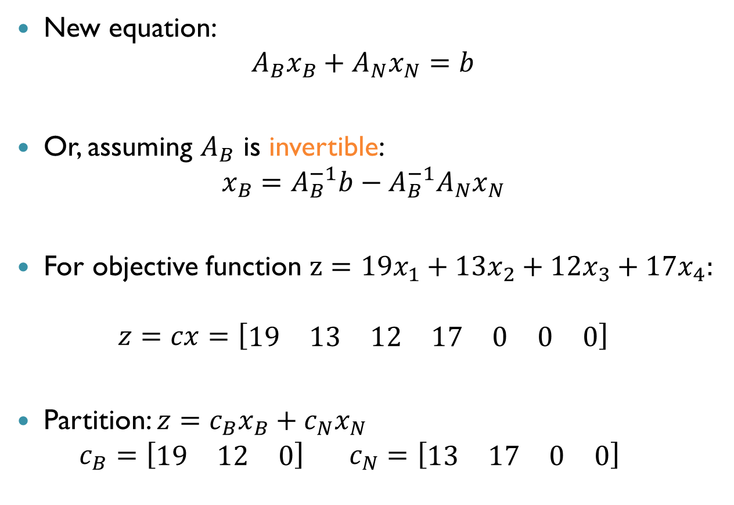
Matrix Representation (cnt’d)
New equation: $A_{B}x_{B}+A_{N}x_{N}=b$
Or, assuming $A_{B}$ is invertible: $x_{B}=A_{B}^{−1}b−A_{B}^{−1}A_{N}x_{N}$
For objective function $z=19x_{1}+13x_{2}+12x_{3}+17x_{4}:$
$$z=cx=\left[\begin{matrix}19 & 13 & 12 & 17 & 0 & 0 & 0\end{matrix}\right]$$
Partition: $z=c_{B}x_{B}+c_{N}x_{N}$ $c_{B}=\left[\begin{matrix}19 & 12 & 0\end{matrix}\right] c_{N}=\left[\begin{matrix}13 & 17 & 0 & 0\end{matrix}\right]$

Slide 10
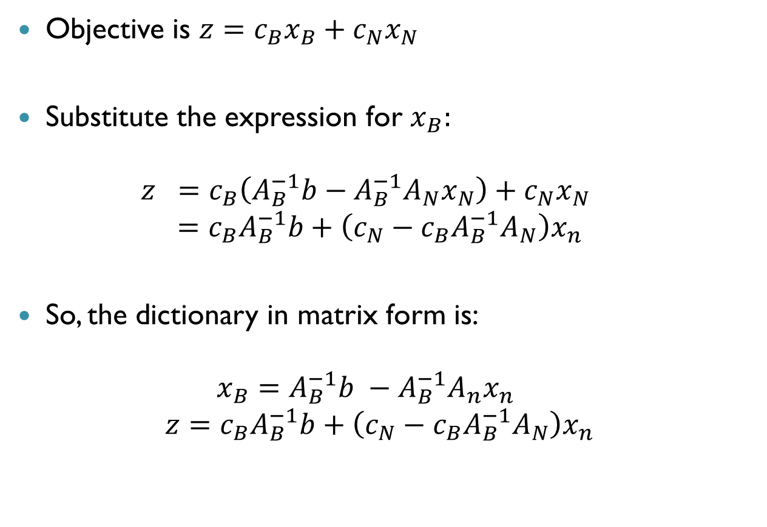
Matrix Representation (cnt’d)
Objective is ${z=c}_{B}x_{B}+c_{N}x_{N}$
Substitute the expression for $x_{B}:$ $z =c_{B}\left(A_{B}^{−1}b−A_{B}^{−1}A_{N}x_{N}\right)+c_{N}x_{N}$
$$=c_{B}A_{B}^{−1}b+\left(c_{N}−c_{B}A_{B}^{−1}A_{N}\right)x_{n}$$
So, the dictionary in matrix form is: $x_{B}=A_{B}^{−1}b −A_{B}^{−1}A_{n}x_{n}$
$$z=c_{B}A_{B}^{−1}b+\left(c_{N}−c_{B}A_{B}^{−1}A_{N}\right)x_{n}$$

Slide 11
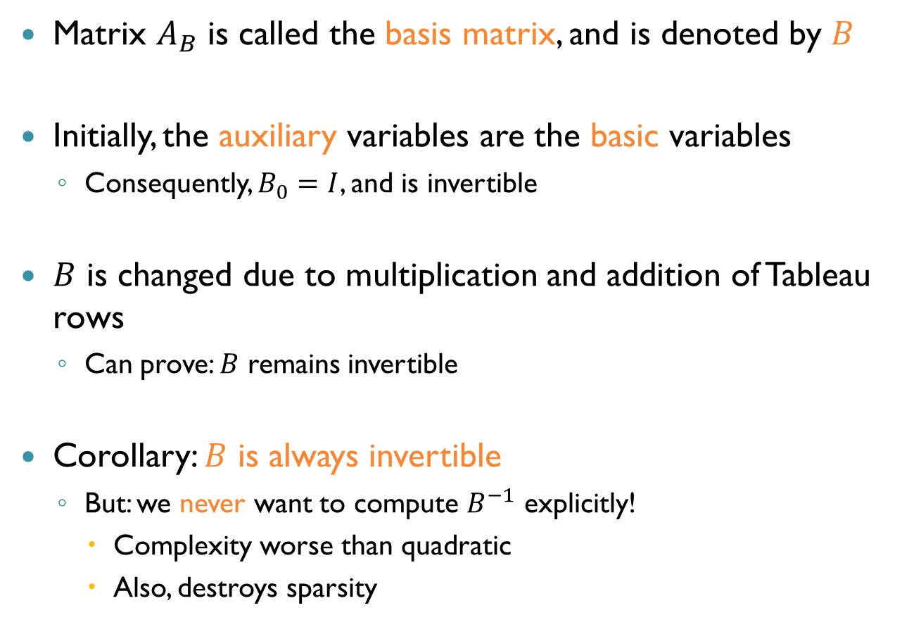
The Basis Matrix
Matrix $A_{B}$ is called the basis matrix, and is denoted by $B$
Initially, the auxiliary variables are the basic variables
Consequently, $B_{0}=I$, and is invertible
$B$ is changed due to multiplication and addition of Tableau rows
Can prove: $B$ remains invertible
Corollary: $B$ is always invertible
But: we never want to compute $B^{−1}$ explicitly!
Complexity worse than quadratic
Also, destroys sparsity

Slide 12
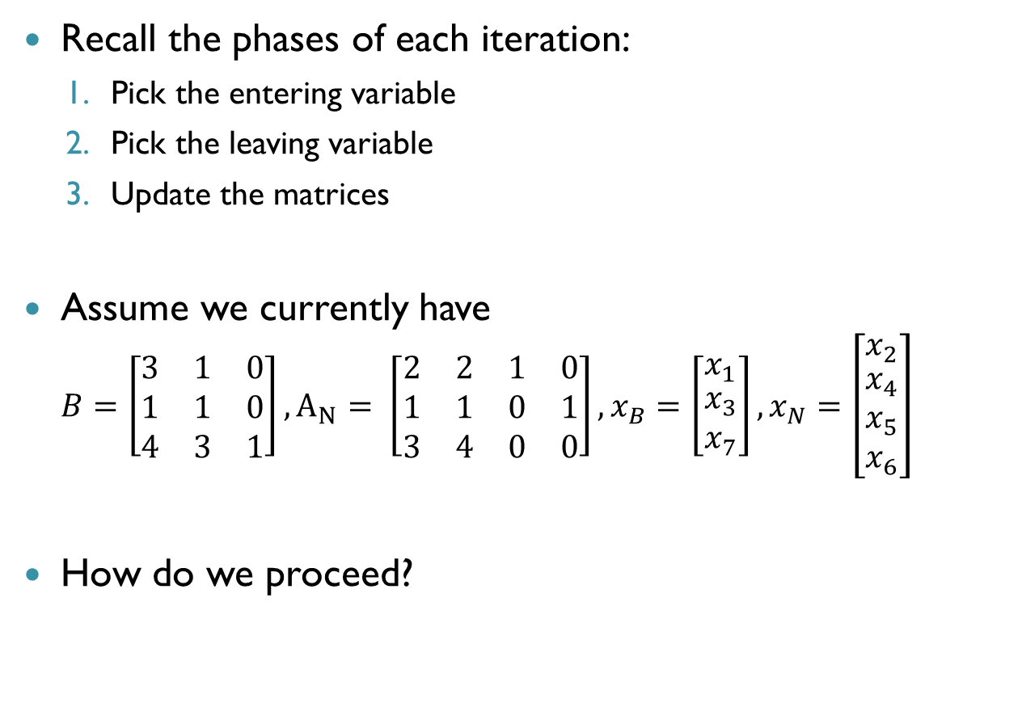
The Revised Simplex Method
Recall the phases of each iteration:
Pick the entering variable
Pick the leaving variable
Update the matrices
Assume we currently have $B=\left[\begin{matrix}3 & 1 & 0 \\ 1 & 1 & 0 \\ 4 & 3 & 1\end{matrix}\right], A_{N}= \left[\begin{matrix}2 & 2 & 1 & 0 \\ 1 & 1 & 0 & 1 \\ 3 & 4 & 0 & 0\end{matrix}\right], x_{B}=\left[\begin{matrix}x_{1} \\ \begin{aligned}x_{3} \\ x_{7}\end{aligned}\end{matrix}\right],x_{N}=\left[\begin{matrix}x_{2} \\ \begin{aligned}x_{4} \\ x_{5} \\ x_{6}\end{aligned}\end{matrix}\right]$
How do we proceed?

Slide 13
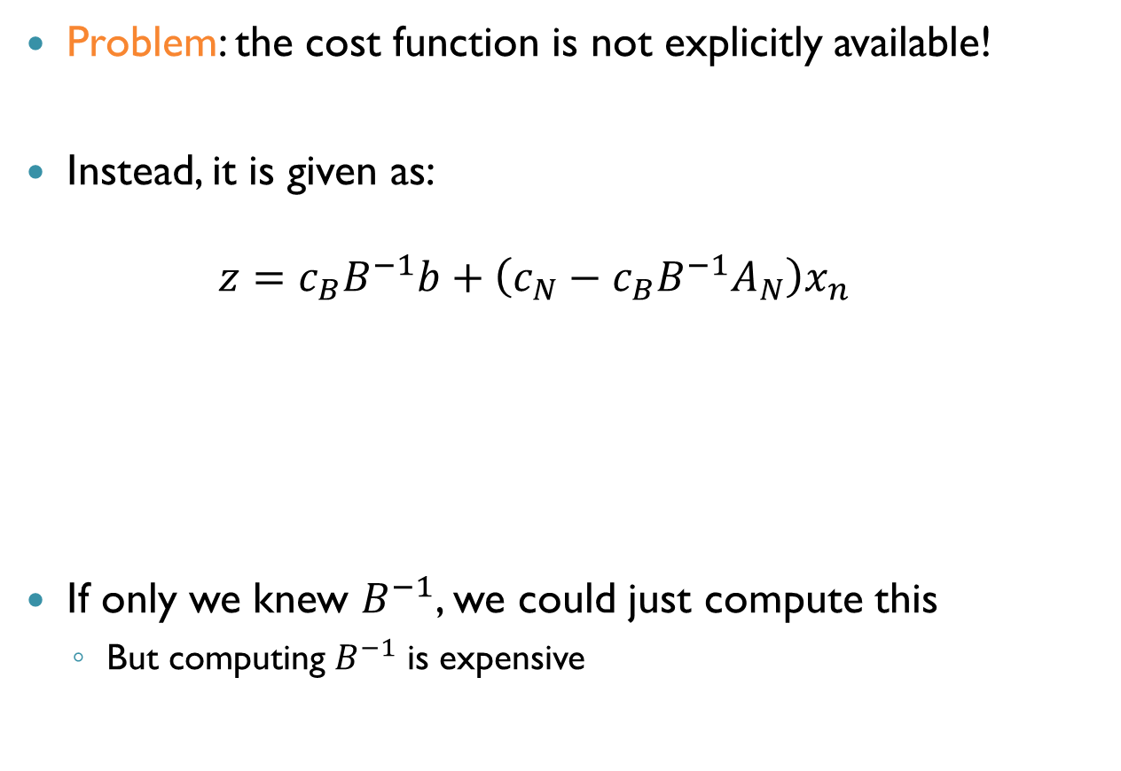
Picking the Entering Variable
Problem: the cost function is not explicitly available!
Instead, it is given as: $z=c_{B}B^{−1}b+\left(c_{N}−c_{B}B^{−1}A_{N}\right)x_{n}$
If only we knew $B^{−1}$, we could just compute this
But computing $B^{−1}$ is expensive
Constant, don’t care
Coefficients, we need them!

Slide 14
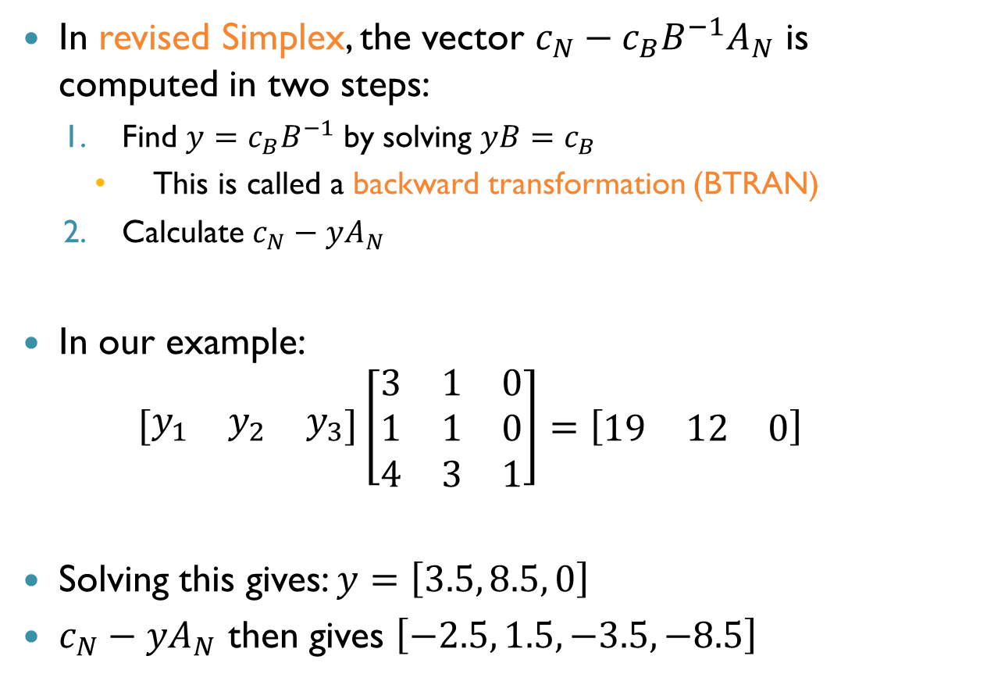
Picking the Entering Variable (cnt’d)
In revised Simplex, the vector $c_{N}−c_{B}B^{−1}A_{N}$ is computed in two steps:
Find $y=c_{B}B^{−1}$ by solving $yB=c_{B}$
This is called a backward transformation (BTRAN)
Calculate $c_{N}−yA_{N}$
In our example: $\left[\begin{matrix}y_{1} & y_{2} & y_{3}\end{matrix}\right]\left[\begin{matrix}3 & 1 & 0 \\ 1 & 1 & 0 \\ 4 & 3 & 1\end{matrix}\right]=\left[\begin{matrix}19 & 12 & 0\end{matrix}\right]$
Solving this gives: $y=\left[3.5, 8.5, 0\right]$
$c_{N}−yA_{N}$ then gives $\left[−2.5, 1.5, −3.5, −8.5\right]$

Slide 15
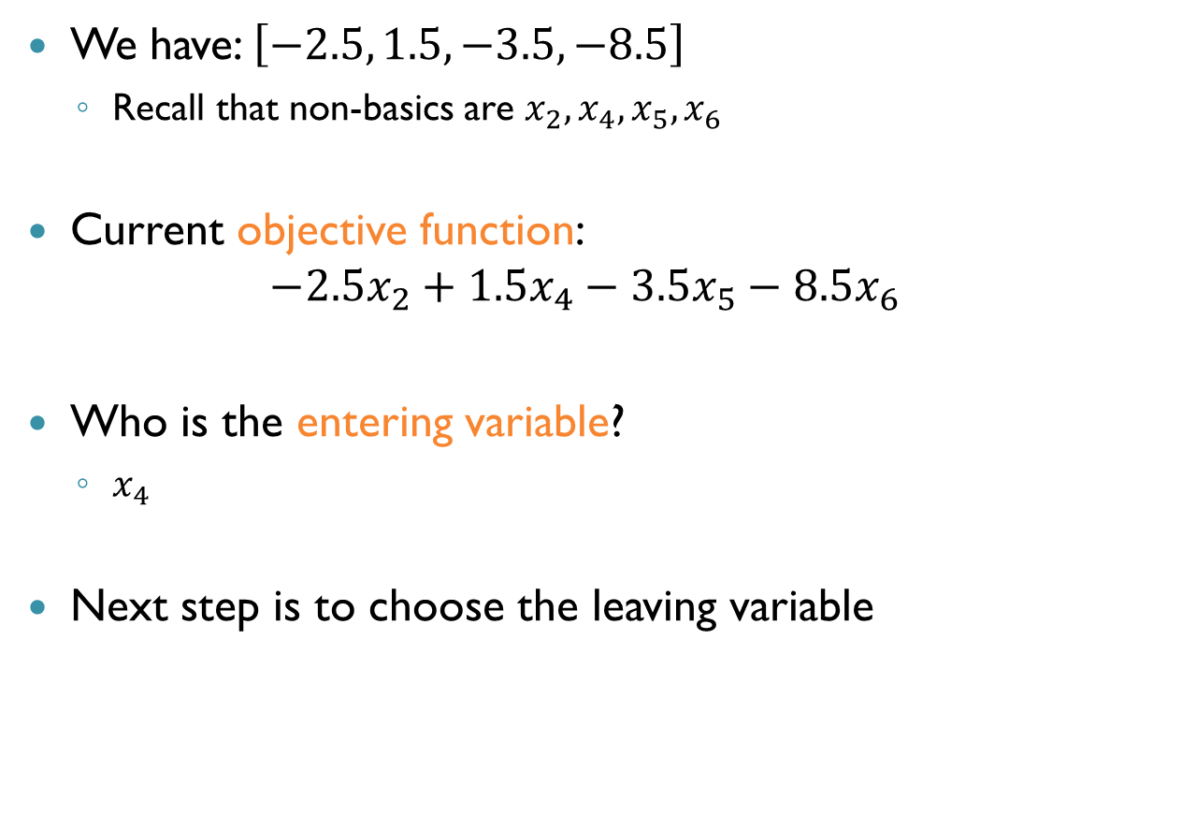
Picking the Entering Variable (cnt’d)
We have: $\left[−2.5, 1.5, −3.5, −8.5\right]$
Recall that non-basics are $x_{2},x_{4},x_{5},x_{6}$
Current objective function: $−2.5x_{2}+1.5x_{4}−3.5x_{5}−8.5x_{6}$
Who is the entering variable?
$x_{4}$
Next step is to choose the leaving variable

Slide 16
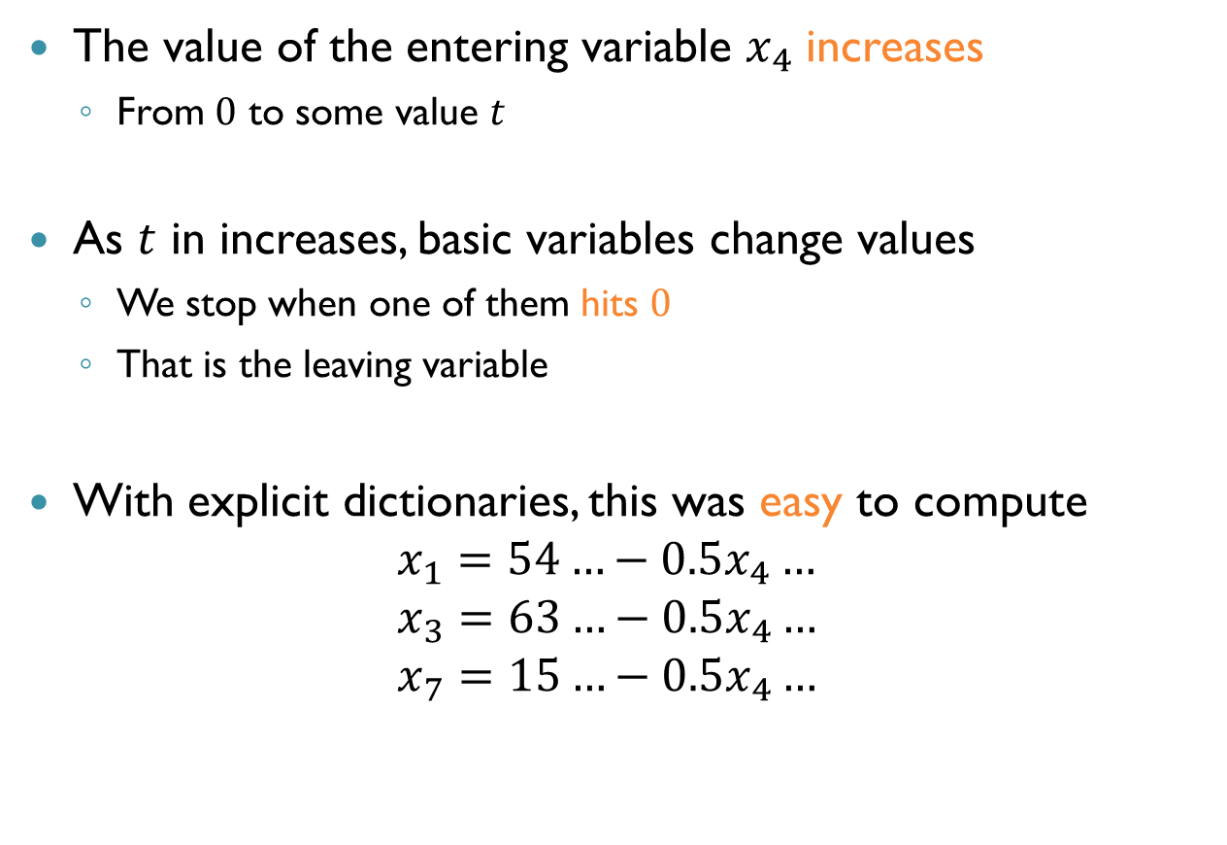
Picking the Leaving Variable
The value of the entering variable $x_{4}$ increases
From $0$ to some value $t$
As $t$ in increases, basic variables change values
We stop when one of them hits $0$
That is the leaving variable
With explicit dictionaries, this was easy to compute
$$x_{1}=54…−0.5x_{4}… \\ x_{3}=63…−0.5x_{4}… \\ x_{7}=15…−0.5x_{4}…$$
Change Column

Slide 17
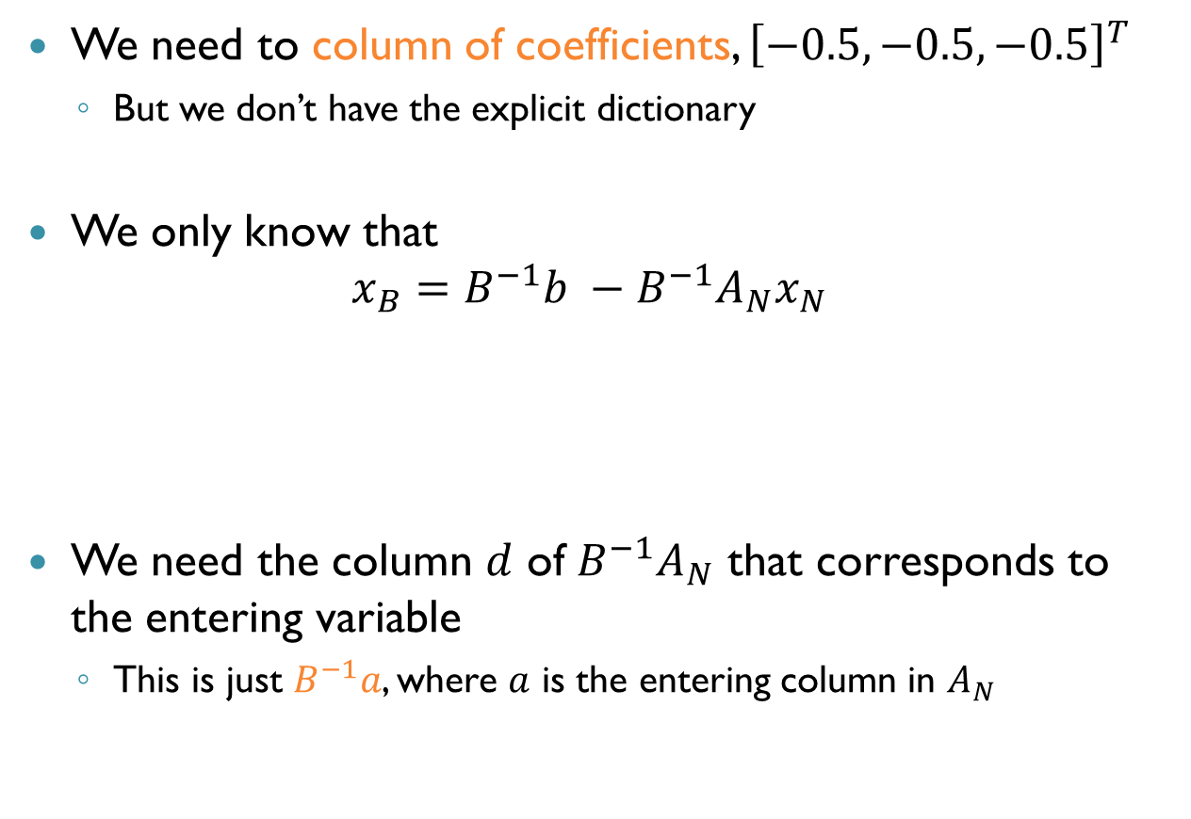
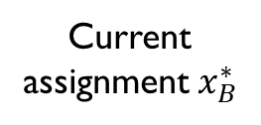
Picking the Leaving Variable (cnt’d)
We need to column of coefficients, ${\left[−0.5, −0.5, −0.5\right]}^{T}$
But we don’t have the explicit dictionary
We only know that $x_{B}=B^{−1}b −B^{−1}A_{N}x_{N}$
We need the column $d$ of $B^{−1}A_{N}$ that corresponds to the entering variable
This is just $B^{−1}a$, where $a$ is the entering column in $A_{N}$
Current assignment $x_{B}^{∗}$
Coefficients, we need them!

Slide 18
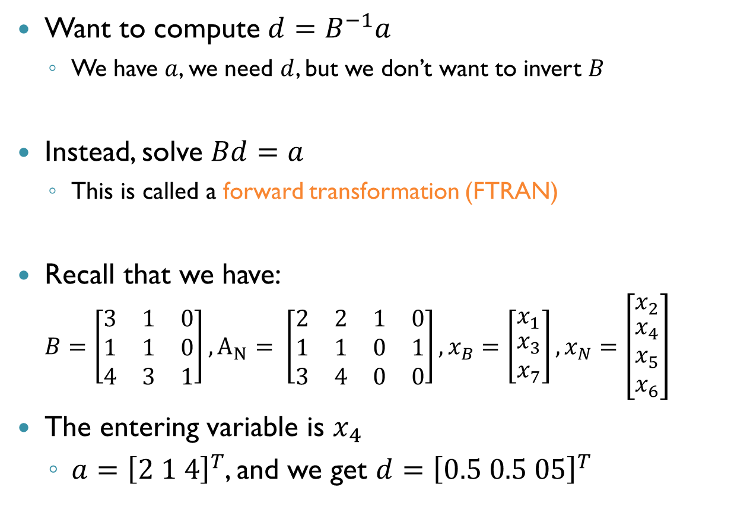
Picking the Leaving Variable (cnt’d)
Want to compute $d=B^{−1}a$
We have $a$, we need $d$, but we don’t want to invert $B$
Instead, solve $Bd=a$
This is called a forward transformation (FTRAN)
Recall that we have: $B=\left[\begin{matrix}3 & 1 & 0 \\ 1 & 1 & 0 \\ 4 & 3 & 1\end{matrix}\right], A_{N}= \left[\begin{matrix}2 & 2 & 1 & 0 \\ 1 & 1 & 0 & 1 \\ 3 & 4 & 0 & 0\end{matrix}\right], x_{B}=\left[\begin{matrix}x_{1} \\ \begin{aligned}x_{3} \\ x_{7}\end{aligned}\end{matrix}\right],x_{N}=\left[\begin{matrix}x_{2} \\ \begin{aligned}x_{4} \\ x_{5} \\ x_{6}\end{aligned}\end{matrix}\right]$
The entering variable is $x_{4}$
$a={\left[2 1 4\right]}^{T}$, and we get $d={\left[0.5 0.5 05\right]}^{T}$

Slide 19

Picking the Leaving Variable (cnt’d)
Column $d$ is ${\left[0.5 0.5 0.5\right]}^{T}$
The current assignment is $\left[x_{1} x_{3} x_{7}\right]=\left[54 63 15\right]$
Consequently, $x_{7}$ is the leaving variable

Slide 20
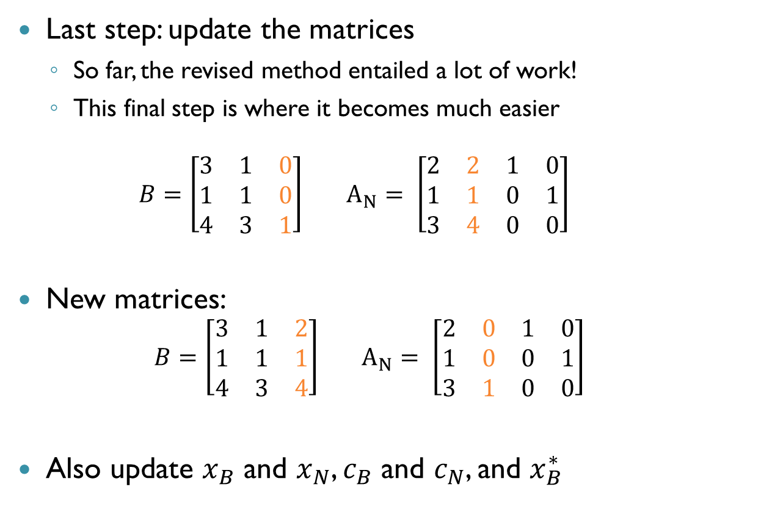
Updating the Basis
Last step: update the matrices
So far, the revised method entailed a lot of work!
This final step is where it becomes much easier $B=\left[\begin{matrix}3 & 1 & 0 \\ 1 & 1 & 0 \\ 4 & 3 & 1\end{matrix}\right] A_{N}= \left[\begin{matrix}2 & 2 & 1 & 0 \\ 1 & 1 & 0 & 1 \\ 3 & 4 & 0 & 0\end{matrix}\right]$
New matrices:
$$B=\left[\begin{matrix}3 & 1 & 2 \\ 1 & 1 & 1 \\ 4 & 3 & 4\end{matrix}\right] A_{N}= \left[\begin{matrix}2 & 0 & 1 & 0 \\ 1 & 0 & 0 & 1 \\ 3 & 1 & 0 & 0\end{matrix}\right]$$
Also update $x_{B}$ and $x_{N}$, $c_{B}$ and $c_{N}$, and $x_{B}^{∗}$

Slide 21
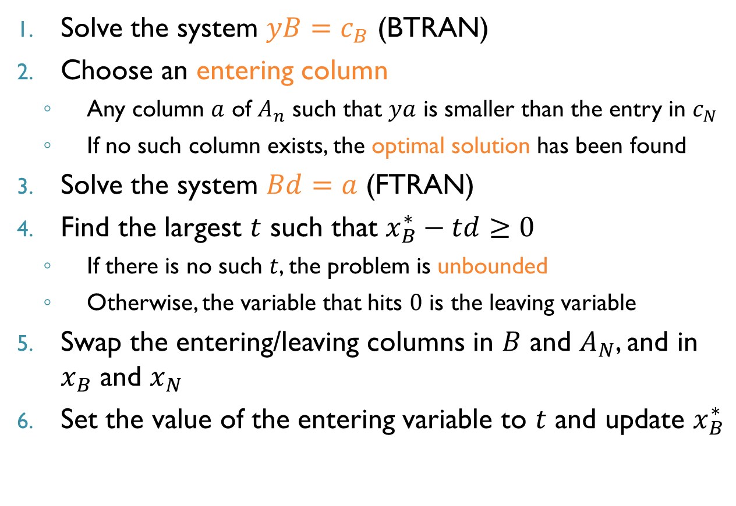
A Revised Simplex Iteration
Solve the system $yB=c_{B}$ (BTRAN)
Choose an entering column
Any column $a$ of $A_{n}$ such that $ya$ is smaller than the entry in $c_{N}$
If no such column exists, the optimal solution has been found
Solve the system $Bd=a$ (FTRAN)
Find the largest $t$ such that $x_{B}^{∗}−td≥0$
If there is no such $t$, the problem is unbounded
Otherwise, the variable that hits $0$ is the leaving variable
Swap the entering/leaving columns in $B$ and $A_{N}$, and in $x_{B}$ and $x_{N}$
Set the value of the entering variable to $t$ and update $x_{B}^{∗}$

Slide 22
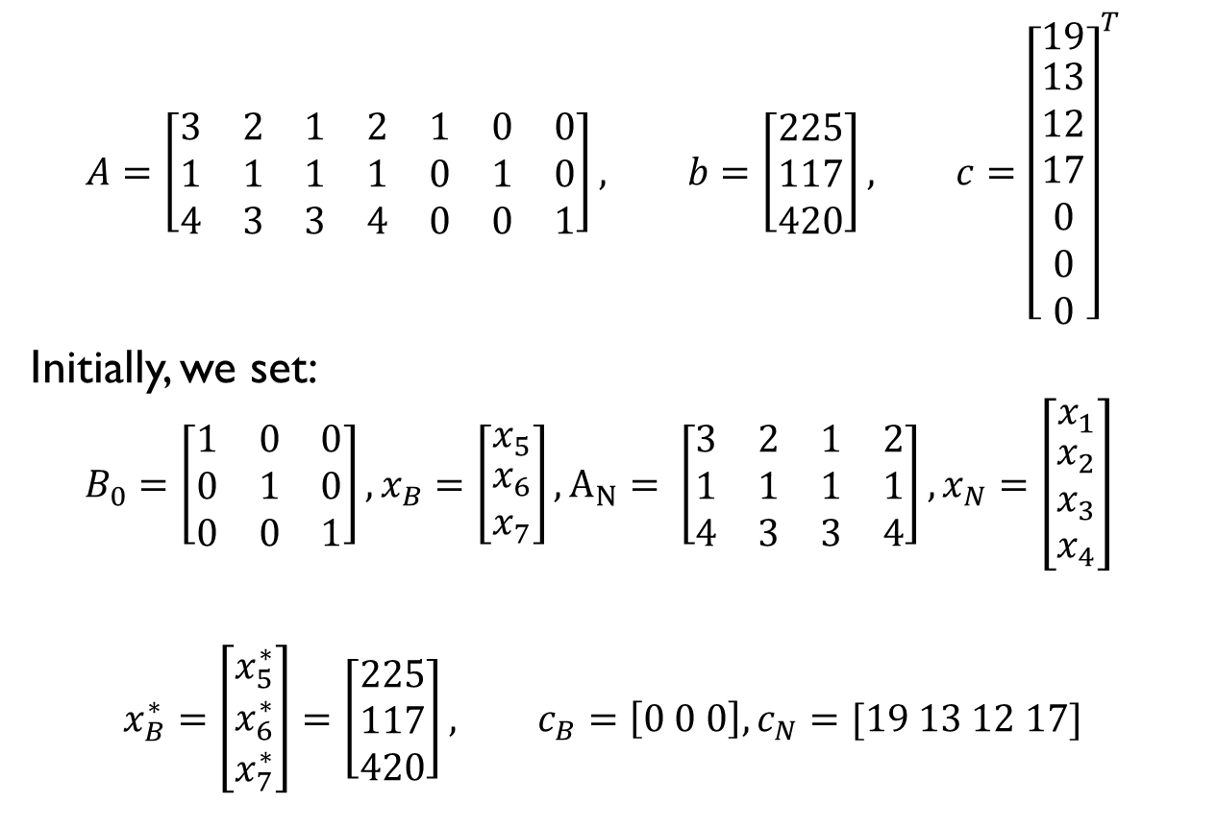
Example
$$A=\left[\begin{matrix}3 & 2 & 1 & 2 & 1 & 0 & 0 \\ 1 & 1 & 1 & 1 & 0 & 1 & 0 \\ 4 & 3 & 3 & 4 & 0 & 0 & 1\end{matrix}\right], b=\left[\begin{aligned}225 \\ 117 \\ 420\end{aligned}\right], c={\left[\begin{matrix}19 \\ \begin{aligned}13 \\ 12 \\ 17 \\ 0 \\ 0 \\ 0\end{aligned}\end{matrix}\right]}^{T}$$
Initially, we set:
$$B_{0}=\left[\begin{matrix}1 & 0 & 0 \\ 0 & 1 & 0 \\ 0 & 0 & 1\end{matrix}\right],x_{B}=\left[\begin{matrix}x_{5} \\ \begin{aligned}x_{6} \\ x_{7}\end{aligned}\end{matrix}\right],A_{N}= \left[\begin{matrix}3 & 2 & 1 & 2 \\ 1 & 1 & 1 & 1 \\ 4 & 3 & 3 & 4\end{matrix}\right],x_{N}=\left[\begin{matrix}x_{1} \\ \begin{aligned}x_{2} \\ x_{3} \\ x_{4}\end{aligned}\end{matrix}\right]$$
$$x_{B}^{∗}=\left[\begin{aligned}x_{5}^{∗} \\ x_{6}^{∗} \\ x_{7}^{∗}\end{aligned}\right]=\left[\begin{aligned}225 \\ 117 \\ 420\end{aligned}\right], c_{B}=\left[0 0 0\right], c_{N}=[19 13 12 17]$$

Slide 23
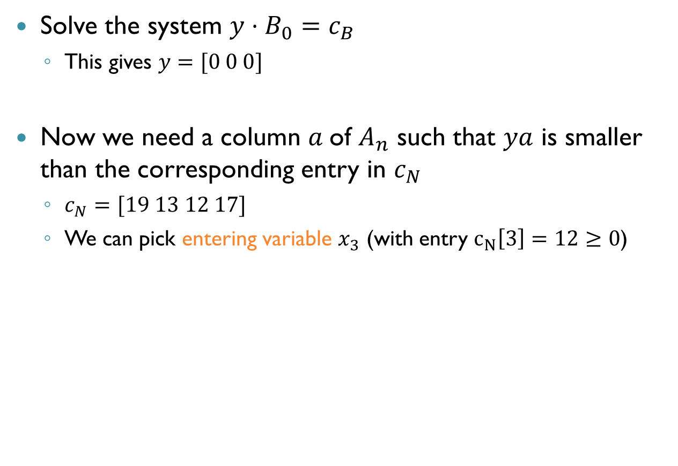

Example: Iteration $1$
Solve the system $y⋅B_{0}=c_{B}$
This gives $y=[0 0 0]$
Now we need a column $a$of $A_{n}$ such that $ya$ is smaller than the corresponding entry in $c_{N}$
$c_{N}=[19 13 12 17]$
We can pick entering variable $x_{3}$ (with entry $c_{N}\left[3\right]=12≥0$)

Slide 24
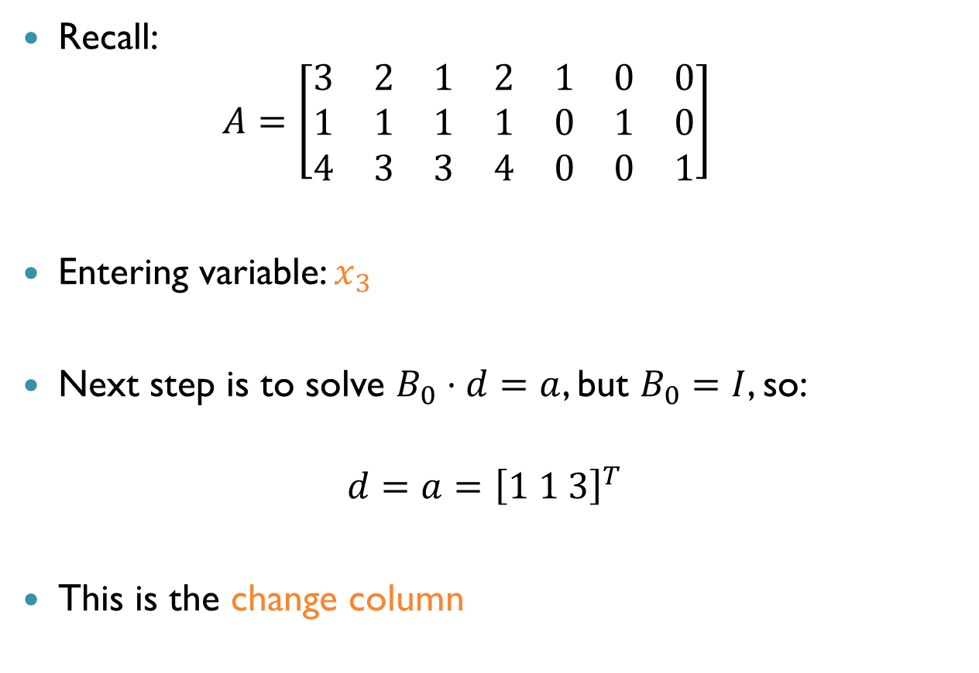

Example: Iteration $1$ (cnt’d)
Recall: $A=\left[\begin{matrix}3 & 2 & 1 & 2 & 1 & 0 & 0 \\ 1 & 1 & 1 & 1 & 0 & 1 & 0 \\ 4 & 3 & 3 & 4 & 0 & 0 & 1\end{matrix}\right]$
Entering variable: $x_{3}$
Next step is to solve $B_{0}⋅d=a$, but $B_{0}=I$, so:
$$d=a={\left[1 1 3\right]}^{T}$$
This is the change column

Slide 25
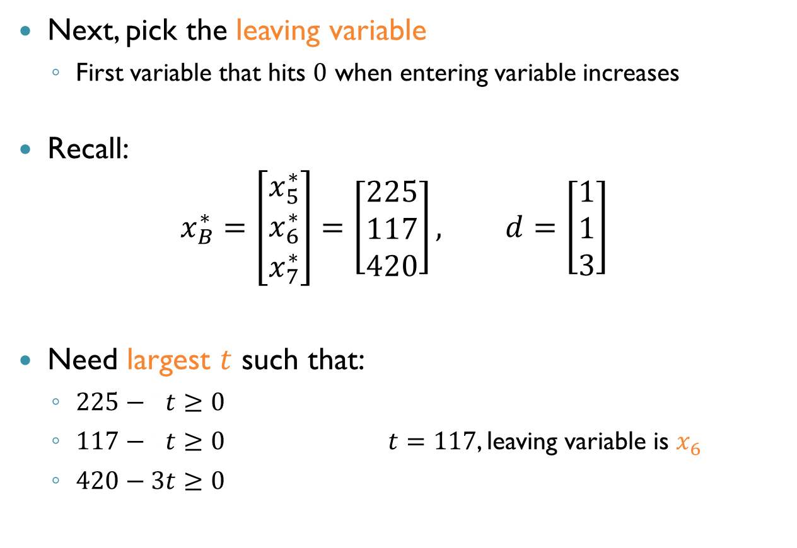
Example: Iteration $1$ (cnt’d)
Next, pick the leaving variable
First variable that hits $0$ when entering variable increases
Recall: $x_{B}^{∗}=\left[\begin{aligned}x_{5}^{∗} \\ x_{6}^{∗} \\ x_{7}^{∗}\end{aligned}\right]=\left[\begin{aligned}225 \\ 117 \\ 420\end{aligned}\right], d=\left[\begin{aligned}1 \\ 1 \\ 3\end{aligned}\right]$
Need largest $t$ such that:
$225−1t≥0$
$117−1t≥0$ $t=117$, leaving variable is $x_{6}$
$420−3t≥0$

Slide 26
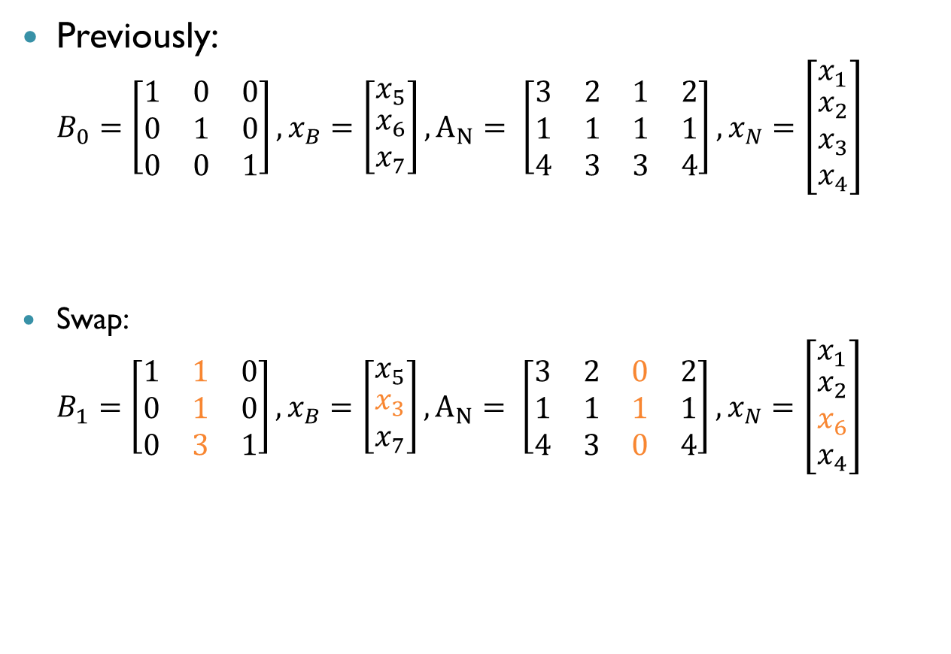
Example: Iteration $1$ (cnt’d)
Previously: $B_{0}=\left[\begin{matrix}1 & 0 & 0 \\ 0 & 1 & 0 \\ 0 & 0 & 1\end{matrix}\right],x_{B}=\left[\begin{matrix}x_{5} \\ \begin{aligned}x_{6} \\ x_{7}\end{aligned}\end{matrix}\right],A_{N}= \left[\begin{matrix}3 & 2 & 1 & 2 \\ 1 & 1 & 1 & 1 \\ 4 & 3 & 3 & 4\end{matrix}\right],x_{N}=\left[\begin{matrix}x_{1} \\ \begin{aligned}x_{2} \\ x_{3} \\ x_{4}\end{aligned}\end{matrix}\right]$
Swap: $B_{1}=\left[\begin{matrix}1 & 1 & 0 \\ 0 & 1 & 0 \\ 0 & 3 & 1\end{matrix}\right],x_{B}=\left[\begin{matrix}x_{5} \\ \begin{aligned}x_{3} \\ x_{7}\end{aligned}\end{matrix}\right],A_{N}= \left[\begin{matrix}3 & 2 & 0 & 2 \\ 1 & 1 & 1 & 1 \\ 4 & 3 & 0 & 4\end{matrix}\right],x_{N}=\left[\begin{matrix}x_{1} \\ \begin{aligned}x_{2} \\ x_{6} \\ x_{4}\end{aligned}\end{matrix}\right]$

Slide 27

Example: Iteration $1$ (cnt’d)
Finally, update the variable assignment: $x_{B}^{∗}=\left[\begin{aligned}x_{5}^{∗} \\ x_{3}^{∗} \\ x_{7}^{∗}\end{aligned}\right]=\left[\begin{aligned}225−1t \\ t \\ 420−3t\end{aligned}\right]=\left[\begin{aligned}108 \\ 117 \\ 69\end{aligned}\right]$
This concludes the first iteration

Slide 28
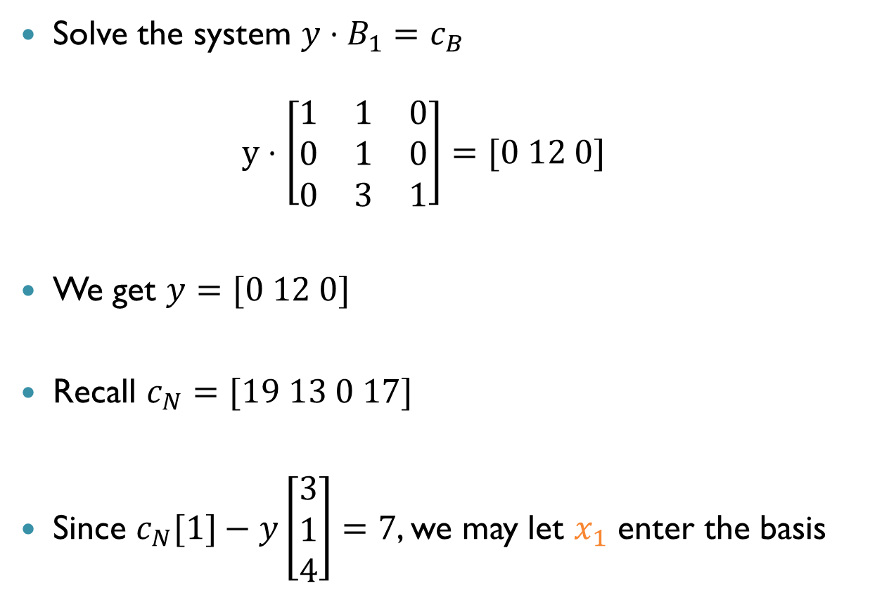
Example: Iteration 2
Solve the system $y⋅B_{1}=c_{B}$ $y⋅\left[\begin{matrix}1 & 1 & 0 \\ 0 & 1 & 0 \\ 0 & 3 & 1\end{matrix}\right]=[0 12 0]$
We get $y=[0 12 0]$
Recall $c_{N}=[19 13 0 17]$
Since $c_{N}[1]−y\left[\begin{aligned}3 \\ 1 \\ 4\end{aligned}\right]=7$, we may let $x_{1}$ enter the basis

Slide 29

Example: Iteration 2 (cnt’d)
Solve the system $B_{1}⋅d=a$: $\left[\begin{matrix}1 & 1 & 0 \\ 0 & 1 & 0 \\ 0 & 3 & 1\end{matrix}\right]⋅d=\left[\begin{aligned}3 \\ 1 \\ 4\end{aligned}\right]$
We get $d=\left[\begin{aligned}2 \\ 1 \\ 1\end{aligned}\right]$

Slide 30

Example: Iteration 2 (cnt’d)
Find largest $t$ such that:
$108−2t≥0$
$117−t≥0$
$69−t≥0$
We get $t=54$, and the leaving variable is $x_{5}$

Slide 31
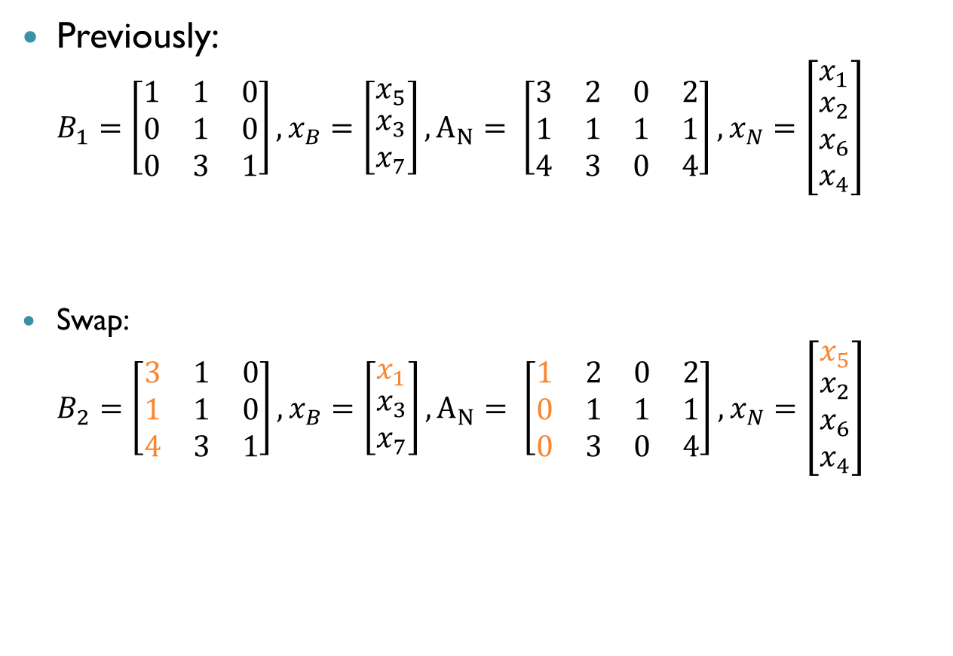

Example: Iteration $2$ (cnt’d)
Previously: $B_{1}=\left[\begin{matrix}1 & 1 & 0 \\ 0 & 1 & 0 \\ 0 & 3 & 1\end{matrix}\right],x_{B}=\left[\begin{matrix}x_{5} \\ \begin{aligned}x_{3} \\ x_{7}\end{aligned}\end{matrix}\right],A_{N}= \left[\begin{matrix}3 & 2 & 0 & 2 \\ 1 & 1 & 1 & 1 \\ 4 & 3 & 0 & 4\end{matrix}\right],x_{N}=\left[\begin{matrix}x_{1} \\ \begin{aligned}x_{2} \\ x_{6} \\ x_{4}\end{aligned}\end{matrix}\right]$
Swap: $B_{2}=\left[\begin{matrix}3 & 1 & 0 \\ 1 & 1 & 0 \\ 4 & 3 & 1\end{matrix}\right],x_{B}=\left[\begin{matrix}x_{1} \\ \begin{aligned}x_{3} \\ x_{7}\end{aligned}\end{matrix}\right],A_{N}= \left[\begin{matrix}1 & 2 & 0 & 2 \\ 0 & 1 & 1 & 1 \\ 0 & 3 & 0 & 4\end{matrix}\right],x_{N}=\left[\begin{matrix}x_{5} \\ \begin{aligned}x_{2} \\ x_{6} \\ x_{4}\end{aligned}\end{matrix}\right]$

Slide 32

Example: Iteration $2$ (cnt’d)
Finally, update the variable assignment: $x_{B}^{∗}=\left[\begin{aligned}x_{1}^{∗} \\ x_{3}^{∗} \\ x_{7}^{∗}\end{aligned}\right]=\left[\begin{aligned}t \\ 117−t \\ 69−t\end{aligned}\right]=\left[\begin{aligned}54 \\ 63 \\ 15\end{aligned}\right]$
This concludes the second iteration

Slide 33
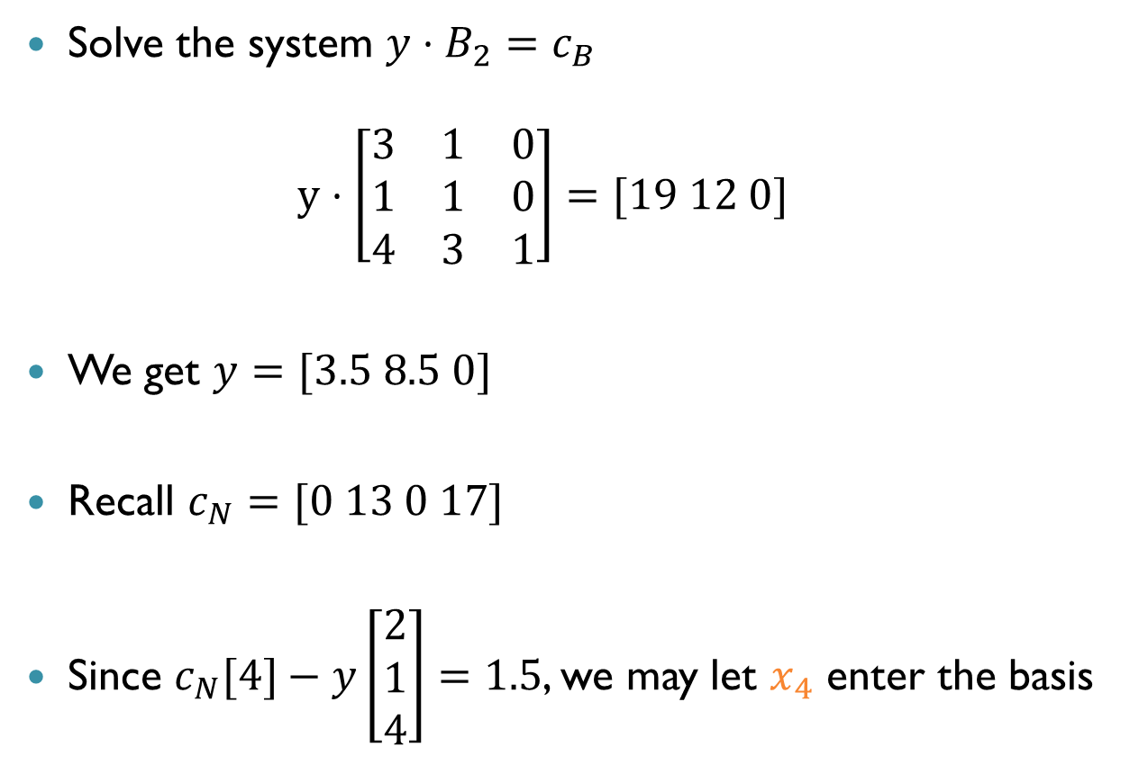
Example: Iteration 3
Solve the system $y⋅B_{2}=c_{B}$ $y⋅\left[\begin{matrix}3 & 1 & 0 \\ 1 & 1 & 0 \\ 4 & 3 & 1\end{matrix}\right]=[19 12 0]$
We get $y=[3.5 8.5 0]$
Recall $c_{N}=[0 13 0 17]$
Since $c_{N}[4]−y\left[\begin{aligned}2 \\ 1 \\ 4\end{aligned}\right]=1.5$, we may let $x_{4}$ enter the basis

Slide 34

Example: Iteration 3 (cnt’d)
Solve the system $B_{2}⋅d=a$: $\left[\begin{matrix}3 & 1 & 0 \\ 1 & 1 & 0 \\ 4 & 3 & 1\end{matrix}\right]⋅d=\left[\begin{aligned}2 \\ 1 \\ 4\end{aligned}\right]$
We get $d=\left[\begin{aligned}0.5 \\ 0.5 \\ 0.5\end{aligned}\right]$

Slide 35

Example: Iteration 3 (cnt’d)
Find largest $t$ such that:
$54−\frac{1}{2}t≥0$
$63−\frac{1}{2}t≥0$
$15−\frac{1}{2}t≥0$
We get $t=30$, and the leaving variable is $x_{7}$

Slide 36
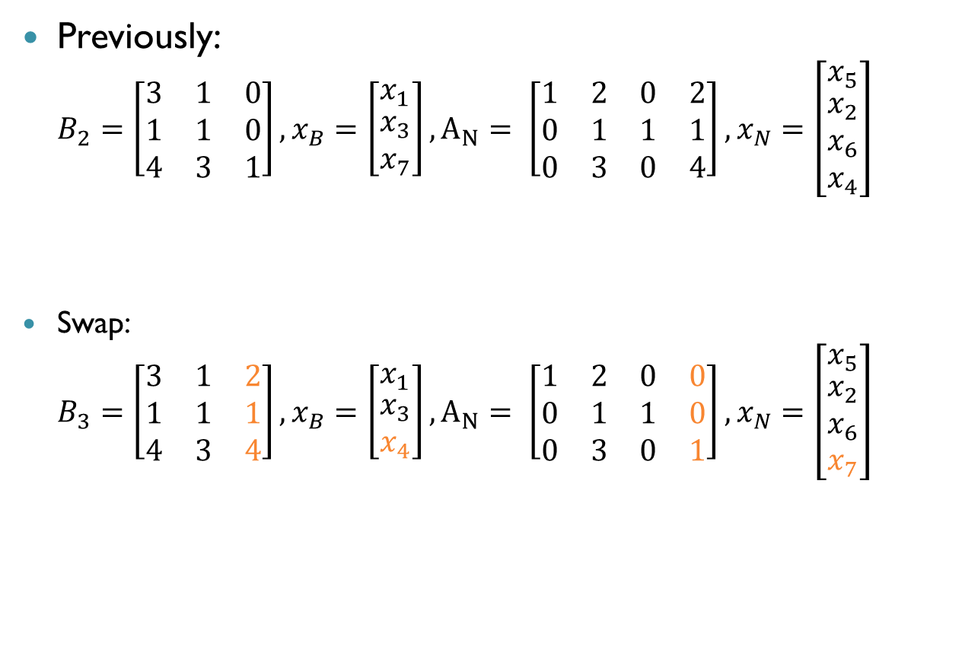

Example: Iteration $3$ (cnt’d)
Previously: $B_{2}=\left[\begin{matrix}3 & 1 & 0 \\ 1 & 1 & 0 \\ 4 & 3 & 1\end{matrix}\right],x_{B}=\left[\begin{matrix}x_{1} \\ \begin{aligned}x_{3} \\ x_{7}\end{aligned}\end{matrix}\right],A_{N}= \left[\begin{matrix}1 & 2 & 0 & 2 \\ 0 & 1 & 1 & 1 \\ 0 & 3 & 0 & 4\end{matrix}\right],x_{N}=\left[\begin{matrix}x_{5} \\ \begin{aligned}x_{2} \\ x_{6} \\ x_{4}\end{aligned}\end{matrix}\right]$
Swap: $B_{3}=\left[\begin{matrix}3 & 1 & 2 \\ 1 & 1 & 1 \\ 4 & 3 & 4\end{matrix}\right],x_{B}=\left[\begin{matrix}x_{1} \\ \begin{aligned}x_{3} \\ x_{4}\end{aligned}\end{matrix}\right],A_{N}= \left[\begin{matrix}1 & 2 & 0 & 0 \\ 0 & 1 & 1 & 0 \\ 0 & 3 & 0 & 1\end{matrix}\right],x_{N}=\left[\begin{matrix}x_{5} \\ \begin{aligned}x_{2} \\ x_{6} \\ x_{7}\end{aligned}\end{matrix}\right]$

Slide 37
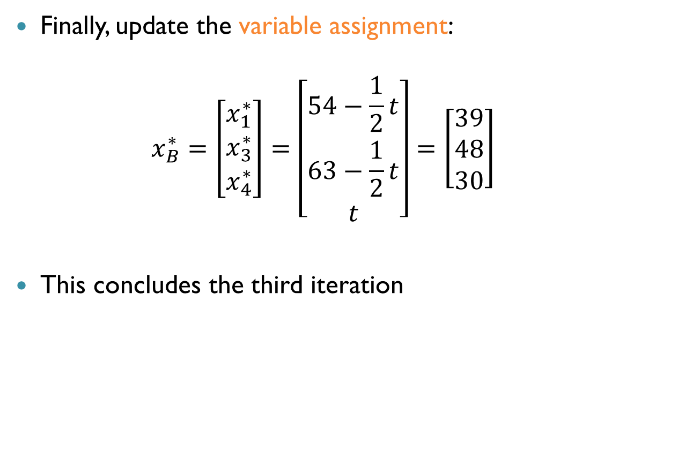
Example: Iteration $3$ (cnt’d)
Finally, update the variable assignment: $x_{B}^{∗}=\left[\begin{aligned}x_{1}^{∗} \\ x_{3}^{∗} \\ x_{4}^{∗}\end{aligned}\right]=\left[\begin{aligned}54−\frac{1}{2}t \\ 63−\frac{1}{2}t \\ t\end{aligned}\right]=\left[\begin{aligned}39 \\ 48 \\ 30\end{aligned}\right]$
This concludes the third iteration

Slide 38
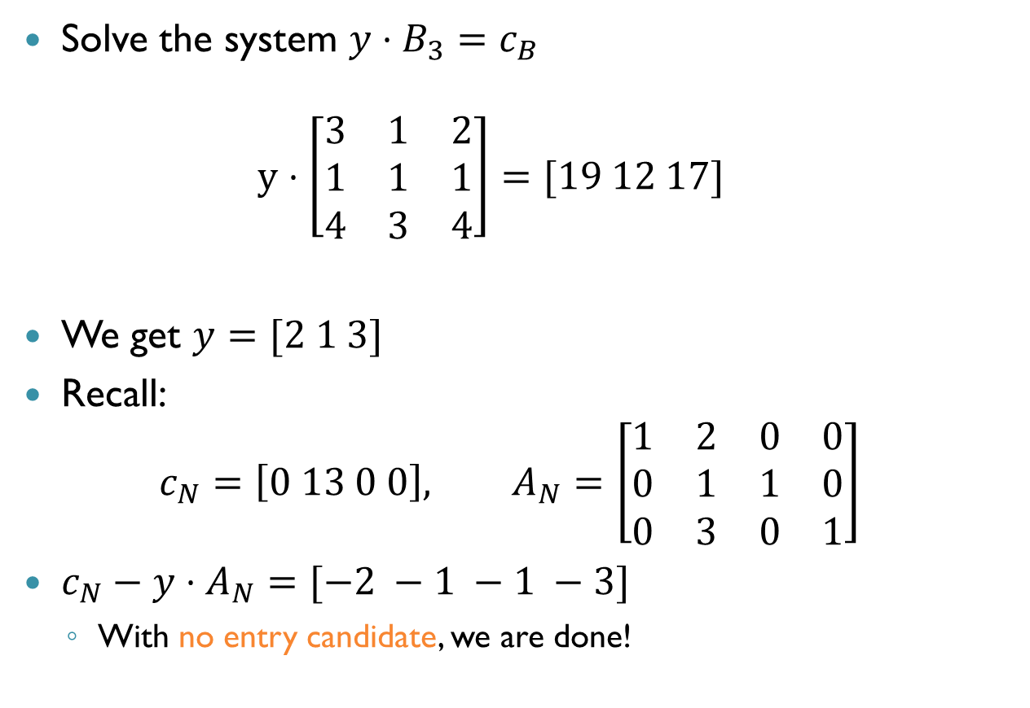
Example: Iteration 4
Solve the system $y⋅B_{3}=c_{B}$ $y⋅\left[\begin{matrix}3 & 1 & 2 \\ 1 & 1 & 1 \\ 4 & 3 & 4\end{matrix}\right]=[19 12 17]$
We get $y=[2 1 3]$
Recall: $c_{N}=\left[0 13 0 0\right], A_{N}=\left[\begin{matrix}1 & 2 & 0 & 0 \\ 0 & 1 & 1 & 0 \\ 0 & 3 & 0 & 1\end{matrix}\right]$
$c_{N}−y⋅A_{N}=[−2 −1 −1 −3]$
With no entry candidate, we are done!

Slide 39
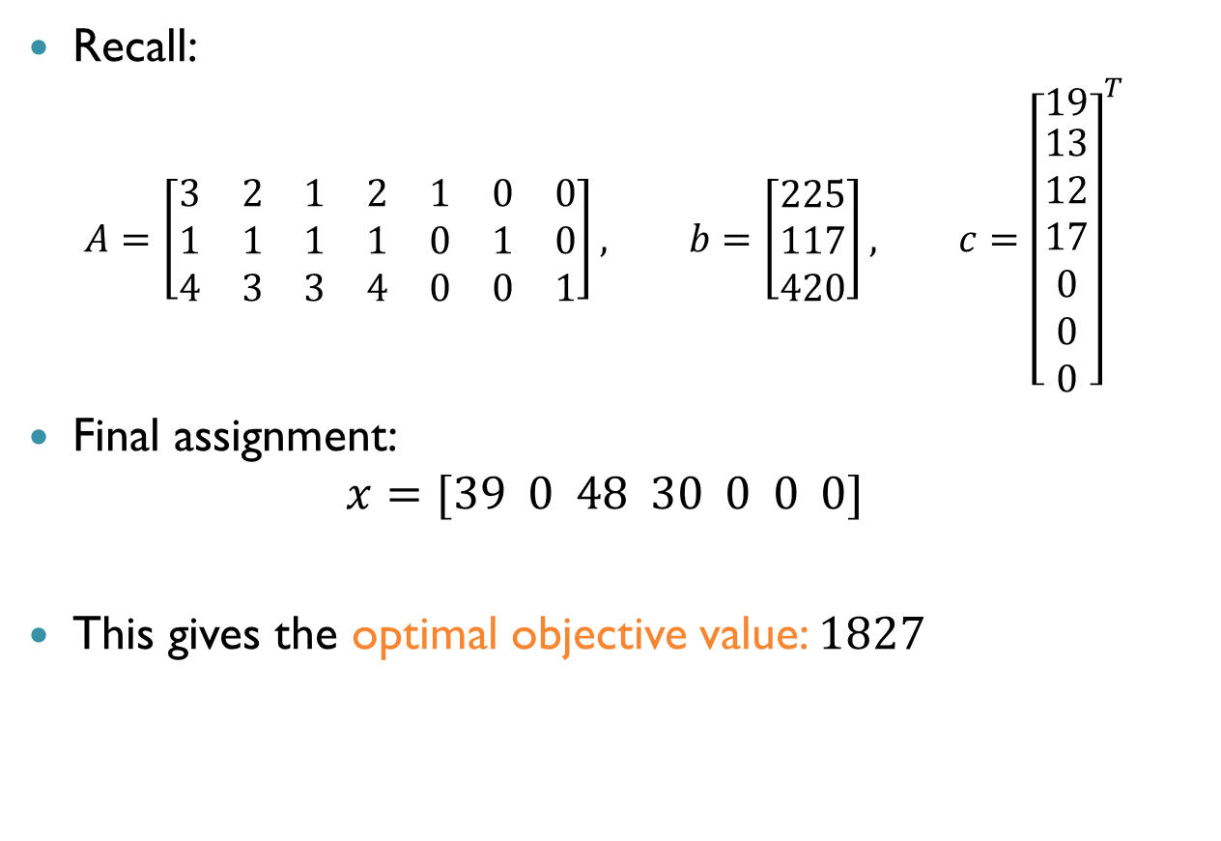
Example: Conclusion
Recall:
$$A=\left[\begin{matrix}3 & 2 & 1 & 2 & 1 & 0 & 0 \\ 1 & 1 & 1 & 1 & 0 & 1 & 0 \\ 4 & 3 & 3 & 4 & 0 & 0 & 1\end{matrix}\right], b=\left[\begin{aligned}225 \\ 117 \\ 420\end{aligned}\right], c={\left[\begin{matrix}19 \\ \begin{aligned}13 \\ 12 \\ 17 \\ 0 \\ 0 \\ 0\end{aligned}\end{matrix}\right]}^{T}$$
Final assignment: $x=[39 0 48 30 0 0 0]$
This gives the optimal objective value: $1827$

Slide 40
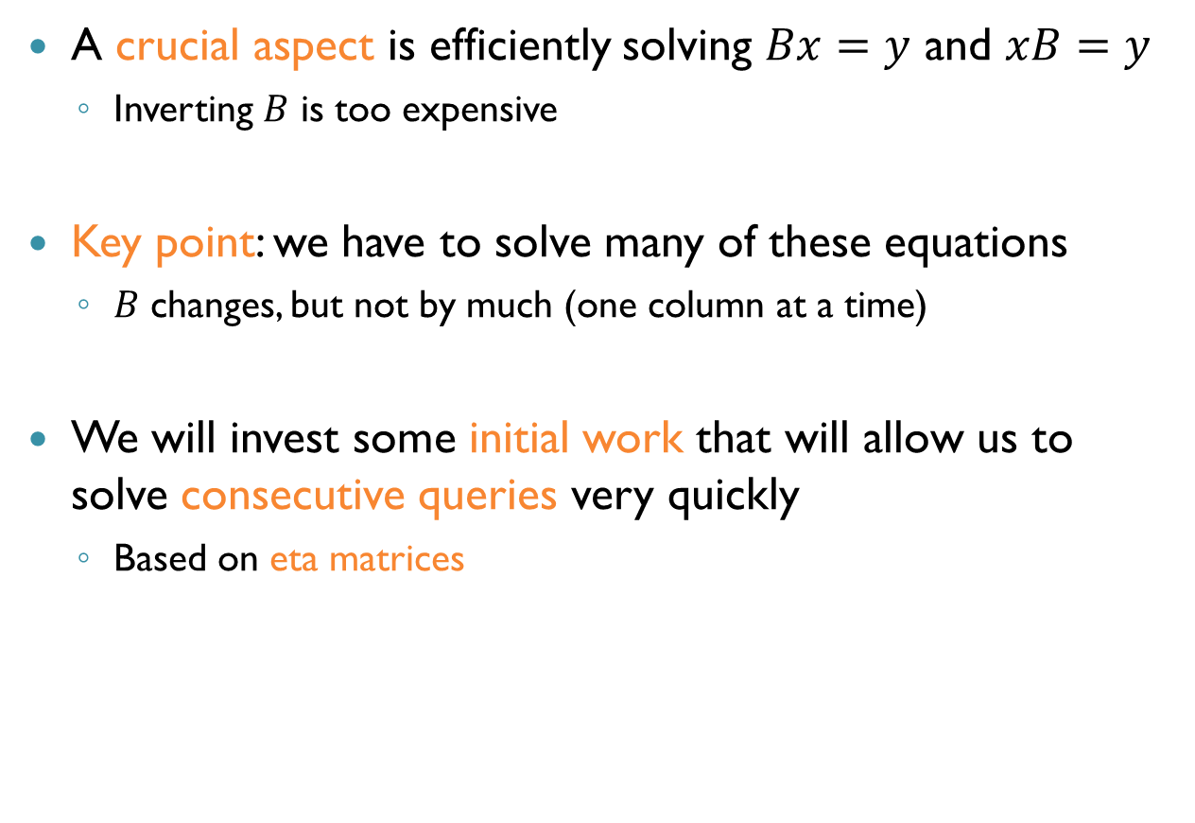
Basis Factorization
A crucial aspect is efficiently solving $Bx=y$ and $xB=y$
Inverting $B$ is too expensive
Key point: we have to solve many of these equations
$B$ changes, but not by much (one column at a time)
We will invest some initial work that will allow us to solve consecutive queries very quickly
Based on eta matrices

Slide 41
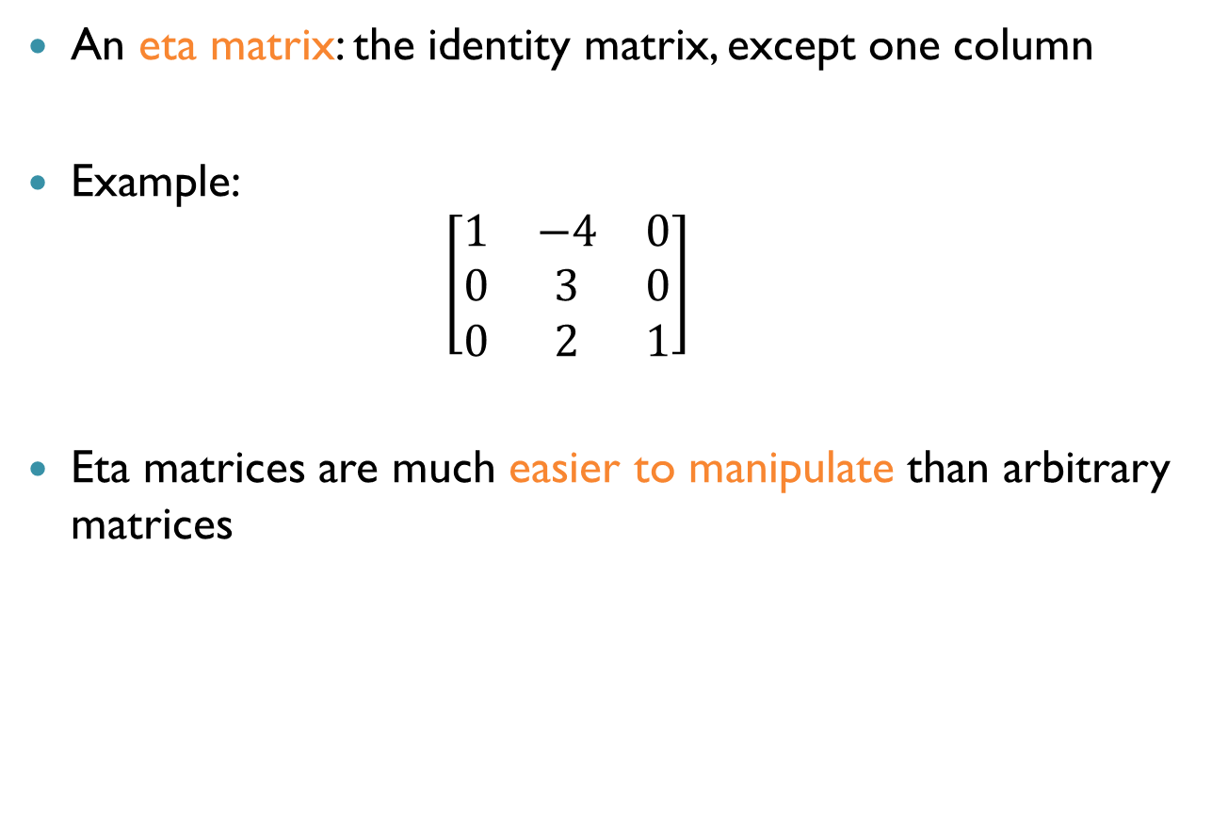
Eta Matrices
An eta matrix: the identity matrix, except one column
Example: $\left[\begin{matrix}1 & −4 & 0 \\ 0 & 3 & 0 \\ 0 & 2 & 1\end{matrix}\right]$
Eta matrices are much easier to manipulate than arbitrary matrices

Slide 42
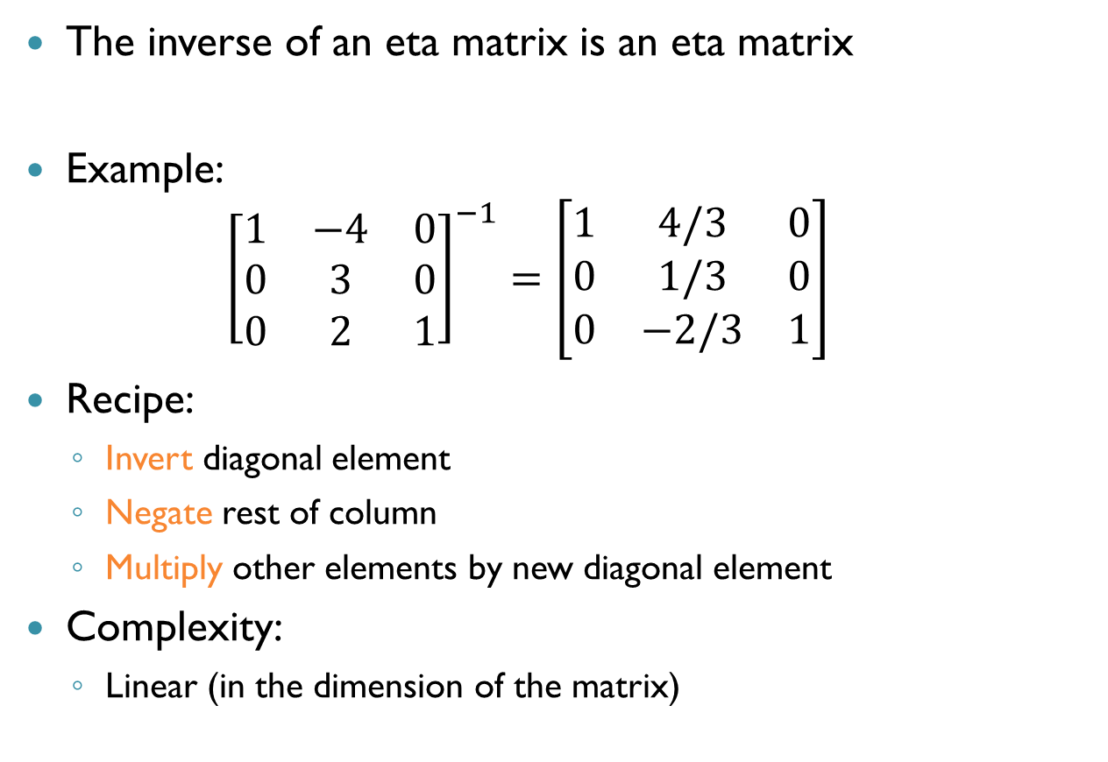
Inverting Eta Matrices
The inverse of an eta matrix is an eta matrix
Example: ${\left[\begin{matrix}1 & −4 & 0 \\ 0 & 3 & 0 \\ 0 & 2 & 1\end{matrix}\right]}^{−1}=\left[\begin{matrix}1 & 4/3 & 0 \\ 0 & 1/3 & 0 \\ 0 & −2/3 & 1\end{matrix}\right]$
Recipe:
Invert diagonal element
Negate rest of column
Multiply other elements by new diagonal element
Complexity:
Linear (in the dimension of the matrix)

Slide 43
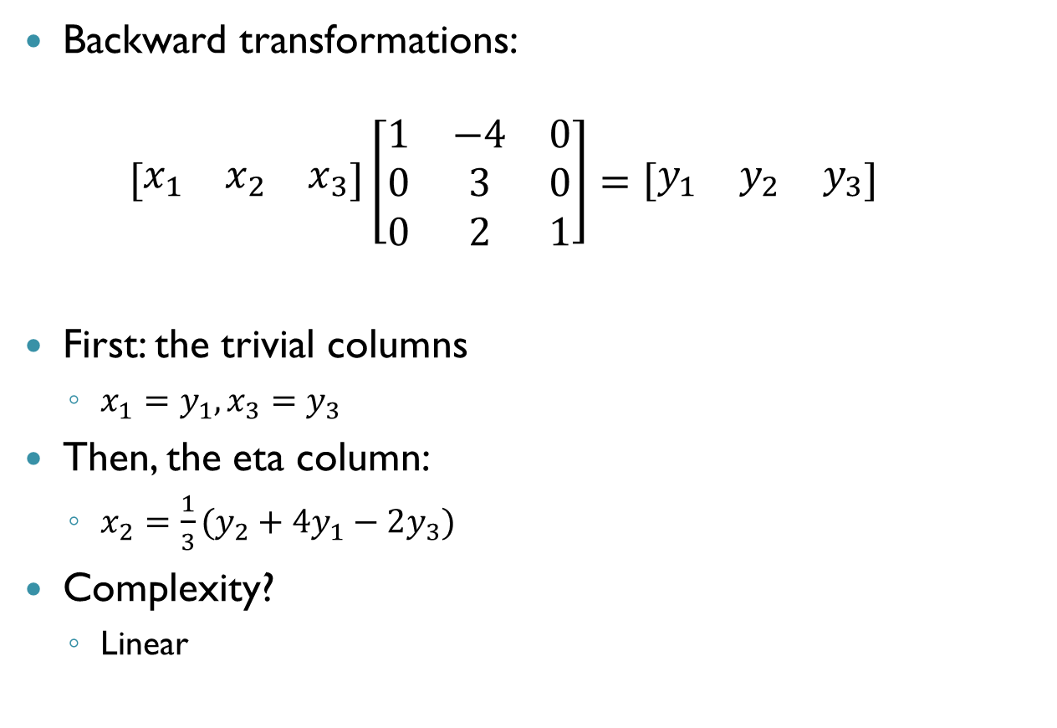
Eta Matrices: BTRAN
Backward transformations: $\left[\begin{matrix}x_{1} & x_{2} & x_{3}\end{matrix}\right]\left[\begin{matrix}1 & −4 & 0 \\ 0 & 3 & 0 \\ 0 & 2 & 1\end{matrix}\right]=\left[\begin{matrix}y_{1} & y_{2} & y_{3}\end{matrix}\right]$
First: the trivial columns
$x_{1}=y_{1}, x_{3}=y_{3}$
Then, the eta column:
$x_{2}=\frac{1}{3}(y_{2}+4y_{1}−2y_{3})$
Complexity?
Linear

Slide 44
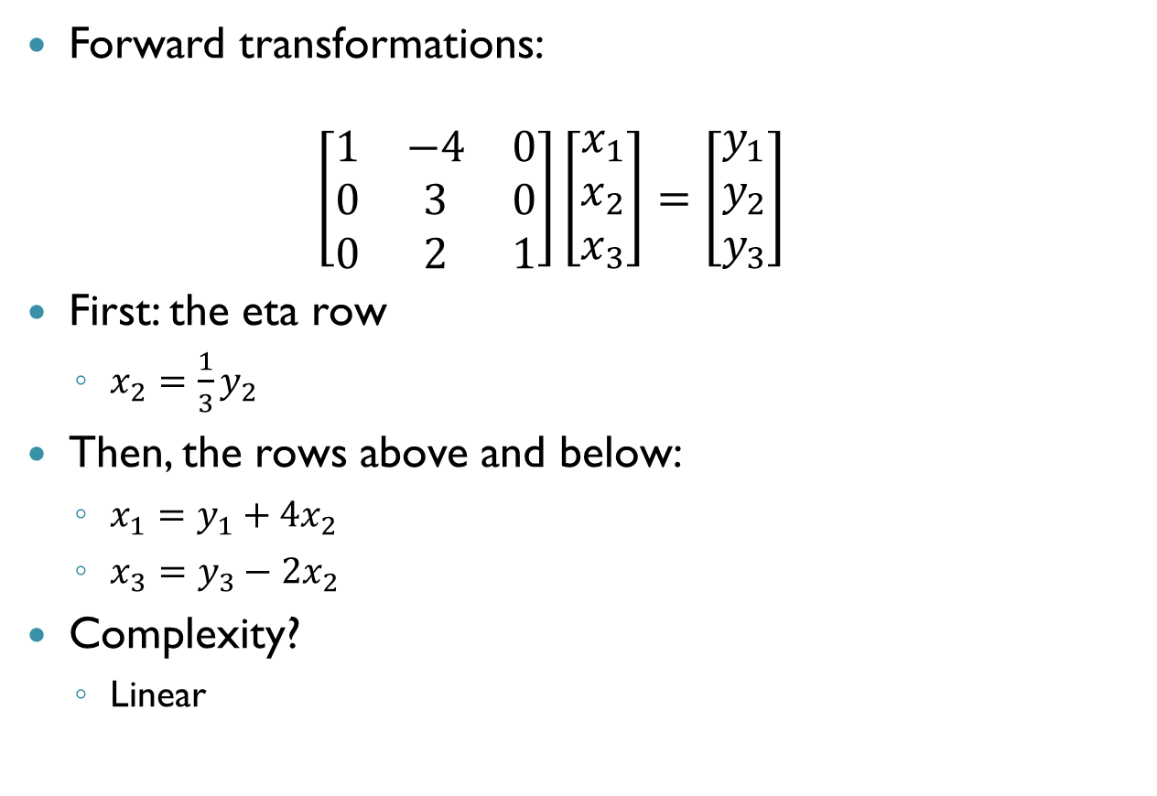
Eta Matrices: FTRAN
Forward transformations: $\left[\begin{matrix}1 & −4 & 0 \\ 0 & 3 & 0 \\ 0 & 2 & 1\end{matrix}\right]\left[\begin{matrix}x_{1} \\ x_{2} \\ x_{3}\end{matrix}\right]=\left[\begin{matrix}y_{1} \\ y_{2} \\ y_{3}\end{matrix}\right]$
First: the eta row
$x_{2}=\frac{1}{3}y_{2}$
Then, the rows above and below:
$x_{1}=y_{1}+4x_{2}$
$x_{3}=y_{3}−2x_{2}$
Complexity?
Linear

Slide 45
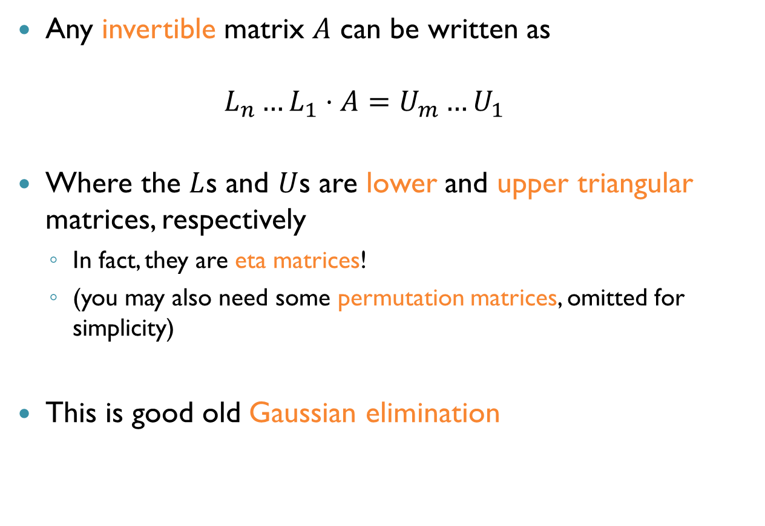
LU-Factorization
Any invertible matrix $A$ can be written as $L_{n}…L_{1}⋅A=U_{m}…U_{1}$
Where the $L$s and $U$s are lower and upper triangular matrices, respectively
In fact, they are eta matrices!
(you may also need some permutation matrices, omitted for simplicity)
This is good old Gaussian elimination

Slide 46

LU-Factorization (cnt’d)
Example: $A=\left[\begin{matrix}3 & 1 & 0 \\ 1 & 1 & 0 \\ 4 & 3 & 1\end{matrix}\right]$
First elimination step:
$R_{2}←R_{2}−\frac{1}{3}R_{1}$, $R_{3}←R_{3}−\frac{4}{3}R_{1}$
This gives: $\left[\begin{matrix}1 & 0 & 0 \\ −1/3 & 1 & 0 \\ −4/3 & 0 & 1\end{matrix}\right]⋅\left[\begin{matrix}3 & 1 & 0 \\ 1 & 1 & 0 \\ 4 & 3 & 1\end{matrix}\right]=\left[\begin{matrix}3 & 1 & 0 \\ 0 & 2/3 & 0 \\ 0 & 5/3 & 1\end{matrix}\right]$

Slide 47
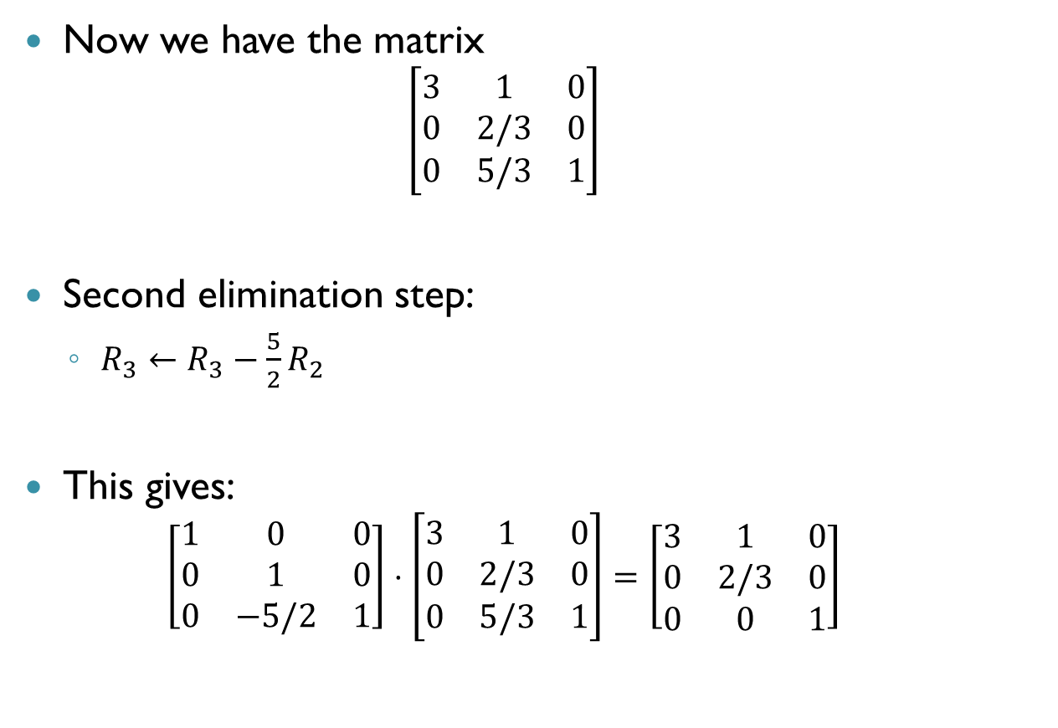
LU-Factorization (cnt’d)
Now we have the matrix $\left[\begin{matrix}3 & 1 & 0 \\ 0 & 2/3 & 0 \\ 0 & 5/3 & 1\end{matrix}\right]$
Second elimination step:
$R_{3}←R_{3}−\frac{5}{2}R_{2}$
This gives: $\left[\begin{matrix}1 & 0 & 0 \\ 0 & 1 & 0 \\ 0 & −5/2 & 1\end{matrix}\right]⋅\left[\begin{matrix}3 & 1 & 0 \\ 0 & 2/3 & 0 \\ 0 & 5/3 & 1\end{matrix}\right]=\left[\begin{matrix}3 & 1 & 0 \\ 0 & 2/3 & 0 \\ 0 & 0 & 1\end{matrix}\right]$

Slide 48
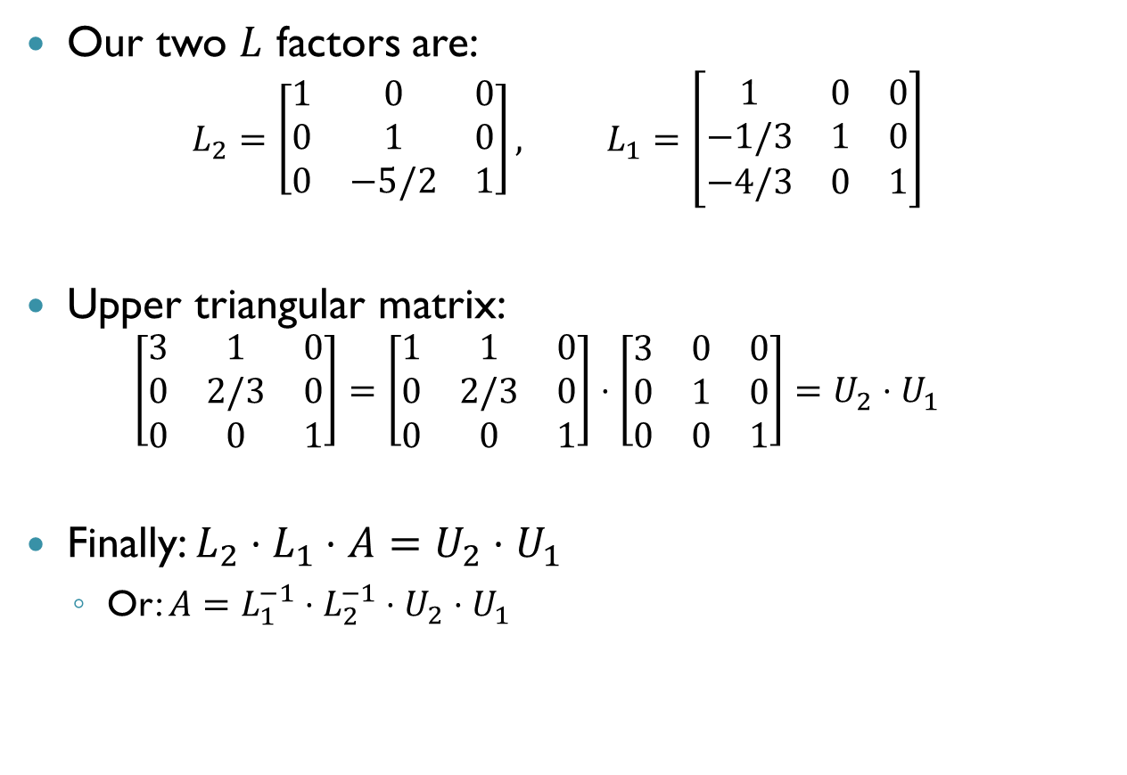
LU-Factorization (cnt’d)
Our two $L$ factors are: $L_{2}=\left[\begin{matrix}1 & 0 & 0 \\ 0 & 1 & 0 \\ 0 & −5/2 & 1\end{matrix}\right], L_{1}=\left[\begin{matrix}1 & 0 & 0 \\ −1/3 & 1 & 0 \\ −4/3 & 0 & 1\end{matrix}\right]$
Upper triangular matrix: $\left[\begin{matrix}3 & 1 & 0 \\ 0 & 2/3 & 0 \\ 0 & 0 & 1\end{matrix}\right]=\left[\begin{matrix}1 & 1 & 0 \\ 0 & 2/3 & 0 \\ 0 & 0 & 1\end{matrix}\right]⋅\left[\begin{matrix}3 & 0 & 0 \\ 0 & 1 & 0 \\ 0 & 0 & 1\end{matrix}\right]=U_{2}⋅U_{1}$
Finally: $L_{2}⋅L_{1}⋅A=U_{2}⋅U_{1}$
Or: $A=L_{1}^{−1}⋅L_{2}^{−1}⋅U_{2}⋅U_{1}$

Slide 49
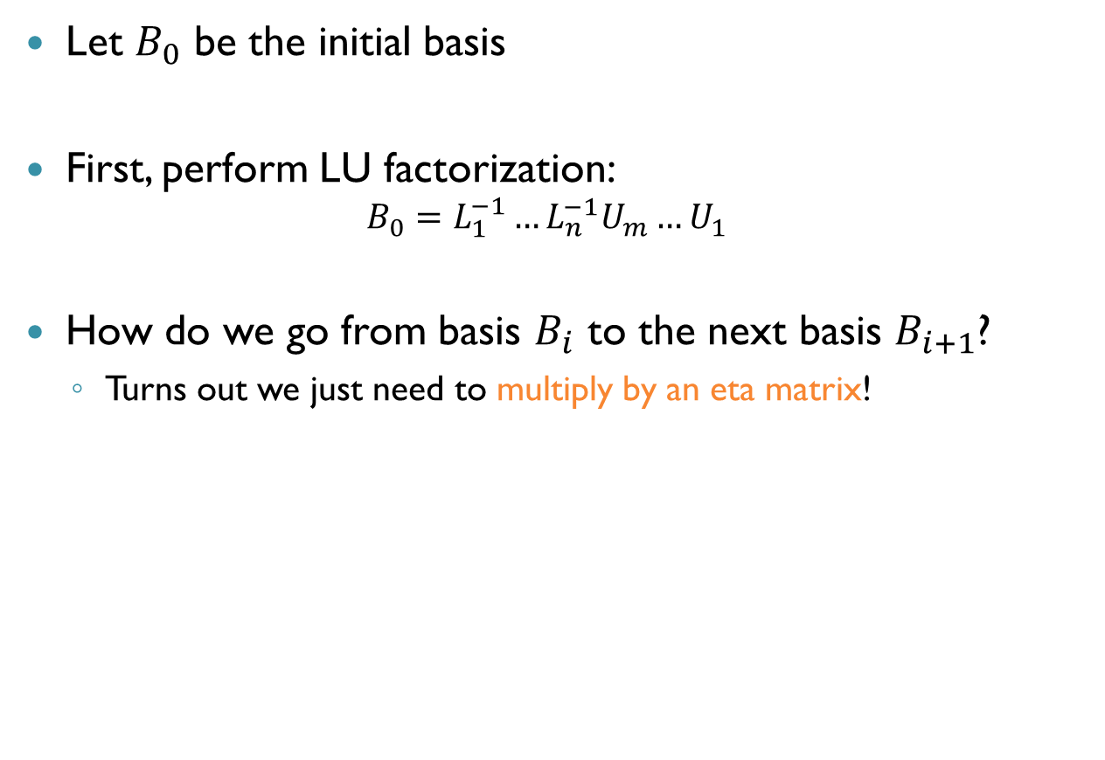
Back to Basis Factorization
Let $B_{0}$ be the initial basis
First, perform LU factorization: $B_{0}=L_{1}^{−1}…L_{n}^{−1}U_{m}…U_{1}$
How do we go from basis $B_{i}$ to the next basis $B_{i+1}$?
Turns out we just need to multiply by an eta matrix!

Slide 50
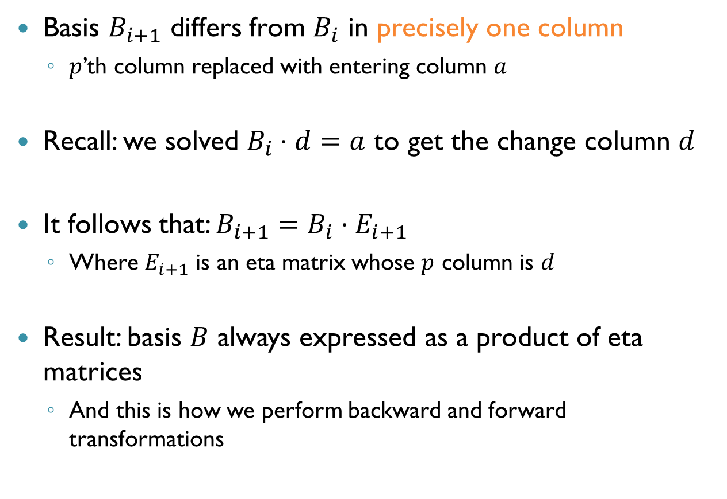
Adjacent Bases
Basis $B_{i+1}$ differs from $B_{i}$ in precisely one column
$p$’th column replaced with entering column $a$
Recall: we solved $B_{i}⋅d=a$ to get the change column $d$
It follows that: $B_{i+1}=B_{i}⋅E_{i+1}$
Where $E_{i+1}$ is an eta matrix whose $p$ column is $d$
Result: basis $B$ always expressed as a product of eta matrices
And this is how we perform backward and forward transformations

Slide 51

Example Revisited
Initially: $B_{0}=I$
First iteration:
Replacing second column, $d=\left[\begin{aligned}1 \\ 1 \\ 3\end{aligned}\right]$
Eta matrix: $E_{1}=\left[\begin{matrix}1 & 1 & 0 \\ 0 & 1 & 0 \\ 0 & 3 & 1\end{matrix}\right]$
$B_{1}=B_{0}⋅E_{1}$

Slide 52

Example Revisited (cnt’d)
Second iteration:
Replacing first column, $d=\left[\begin{aligned}2 \\ 1 \\ 1\end{aligned}\right]$
Eta matrix: $E_{2}=\left[\begin{matrix}2 & 0 & 0 \\ 1 & 1 & 0 \\ 1 & 0 & 1\end{matrix}\right]$
$B_{2}=B_{0}⋅E_{1}⋅E_{2}$

Slide 53

Example Revisited (cnt’d)
Third iteration:
Solve $y⋅B_{2}=[19 12 0]$, i.e. $y⋅B_{0}⋅E_{1}⋅E_{2}=[19 12 0]$
$B_{0}$ is the identity, so $y⋅E_{1}⋅E_{2}=\left[19 12 0\right]$
Denote $z=y⋅E_{1},$ to obtain $z⋅\left[\begin{matrix}2 & 0 & 0 \\ 1 & 1 & 0 \\ 1 & 0 & 1\end{matrix}\right]=[19 12 0]$
This is just a BTRAN operation!
$z=[3.5 12 0]$
Now solve: $y⋅E_{1}=z:$ $y⋅\left[\begin{matrix}1 & 1 & 0 \\ 0 & 1 & 0 \\ 0 & 3 & 1\end{matrix}\right]=[3.5 12 0]$
$y=[3.5 8.5 0]$

Slide 54
Basis Refactoring
Basis factorization allows us to perform backward and forward transformations quickly
Basis expressed as products of eta matrices
Each iteration adds another matrix to the product
Eventually, list becomes too long!

Slide 55

Basis Refactoring (cnt’d)
When too many etas are accumulated, refactorize:
Take the current $B$ and compute a fresh $LU$ factorization
Clear previous eta matrices
… and start accumulating eta matrices again
What is a good threshold for refactorization?
Various estimates
Depends on many factors (e.g., sparsity)

Slide 56

Some Other Points
In our examples, $x_{i}≥0$ for all $i$
In practice, variables have arbitrary bounds: $l≤x≤u$
Method is similar, except non-basic variables pressed against lower or upper bounds
Basis factorization is important for performing transformations quickly
LU factorization is just one kind, there are others
Reid’s, Forrest-Tomlin’s, Saunder’s methods, and others

Slide 57

Numerical Stability
Computation typically performed using floating point arithmetic
This causes round-off errors and imprecisions
Example:
Entering variable: non-negative component of $c_{N}−yA_{N}$
What if this entry is positive only because of a round-off error?
Solution: zero tolerances
Pick component of $c_{N}−yA_{n}$ greater than small $ε>0$

Slide 58

Numerical Stability (cnt’d)
Another instance: diagonal elements of eta matrices
We divide by these diagonal elements when we perform transformations
Division by small numbers leads to big errors
Solution: pick entering variables so that diagonal elements of eta matrices are larger than some $ε>0$
Another safeguard: check that $Bx_{B}^{∗}$ is $ε$-close to $b$
If not, immediately refactorize the basis

Slide 59
Summary
Revised simplex: an efficient way to do simplex
Dictionary stored implicitly
More work for each iteration, but switching bases is easy
Basis factorization: an efficient device for performing backward and forward transformations
Key point: adjacent bases differ only in one column
Have to think about numerical stability
Next time: applications!

